Slide 1
Announcements?

Slide 2
Probability and CS70
Introduction
Probability and CS70
Probability Spaces
Event Probability
Event Probability Examples
Counting Sample Points
Counting Weighted Sample Points
Poker Hands
Balls and Bins
The Birthday Paradox
Summary of Examples
The Monty Hall Problem
Simple Analysis
Sample Space Analysis
Lecture 15, CS70 Fall 2025

Slide 3
A 9 Percent Chance
”A team of researchers from the University of Hawaiʻi at Mānoa published a study this week that estimated the probability of a magnitude 9+ earthquake in the Aleutian Islands—an event with sufficient power to create a mega-tsunami especially threatening to Hawaiʻi. In the next 50 years, they report, there is a 9 percent chance of such an event.” - The School of Ocean and Earth Science and Technology at the University of Hawai‘i at Mānoa

Slide 4

Probability and Intuition
Suppose we flip a coin 20 times. Which outcome is most likely?
HHHHHHHHHHHHHHHHHHHH
HHTTHTHHHTTHTHTHHTHTH
https://joshh.ug/A

Slide 5
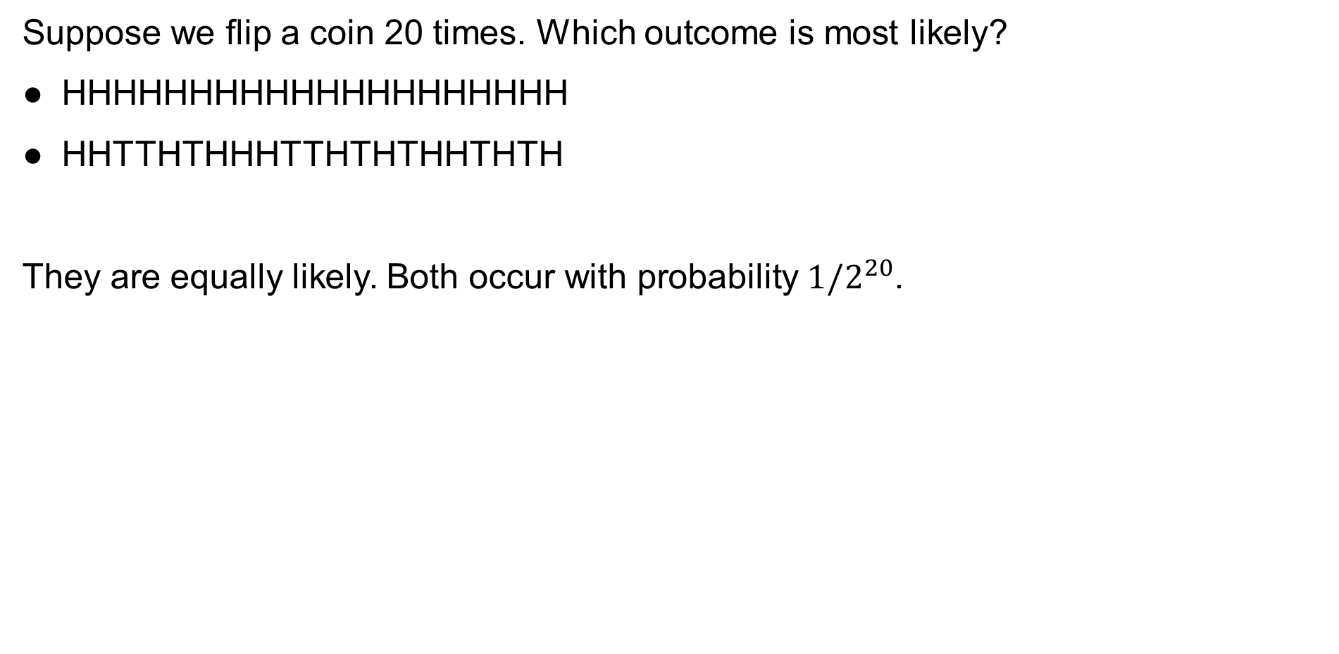
Probability and Intuition
Suppose we flip a coin 20 times. Which outcome is most likely?
HHHHHHHHHHHHHHHHHHHH
HHTTHTHHHTTHTHTHHTHTH
They are equally likely. Both occur with probability $1/2^{20}$.

Slide 6
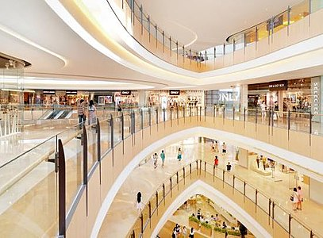
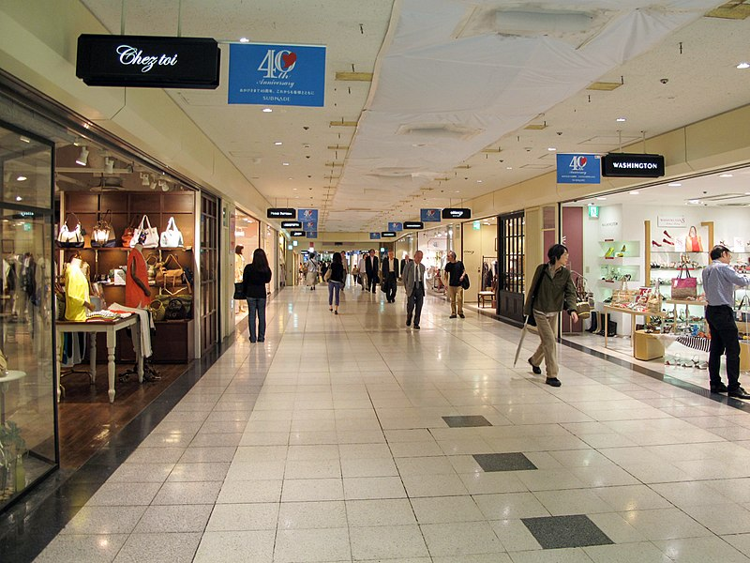
Probability and Intuition
Suppose we have two shopping centers.
Suppose we pick a center randomly with probability 50% and then pick a restaurant at that center with equal probability.
If we eat at a Moroccan restaurant, what is the chance we picked center 1?
Shopping center 1:
3 Indian restaurants
2 Moroccan restaurants
Shopping center 2:
1 Indian restaurant
1 Moroccan restaurant

Slide 7
Probability and CS70
In this second half of CS70, we’ll give you a solid foundation for probability.
What did the “9%” mean in that chance for a mega-tsunami?
Which outcome is more likely for coin flipping?
What is the chance we picked shopping center 1?
Probabilistic reasoning is famously counterintuitive!
A firm foundation will keep you safe from easy mistakes.

Slide 8
Probability
This second phase of the class is a bit of a restart.
We will build upon the first half, particularly upon our efforts with:
Writing formal proofs.
Counting.
Other topics like induction, stable matching, graphs, modular arithmetic, error correcting codes, countability, computability, and so forth will mostly not be used.

Slide 9
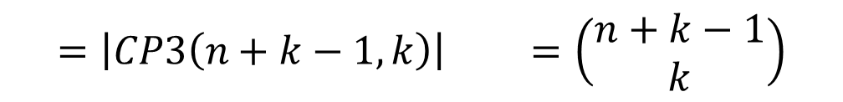
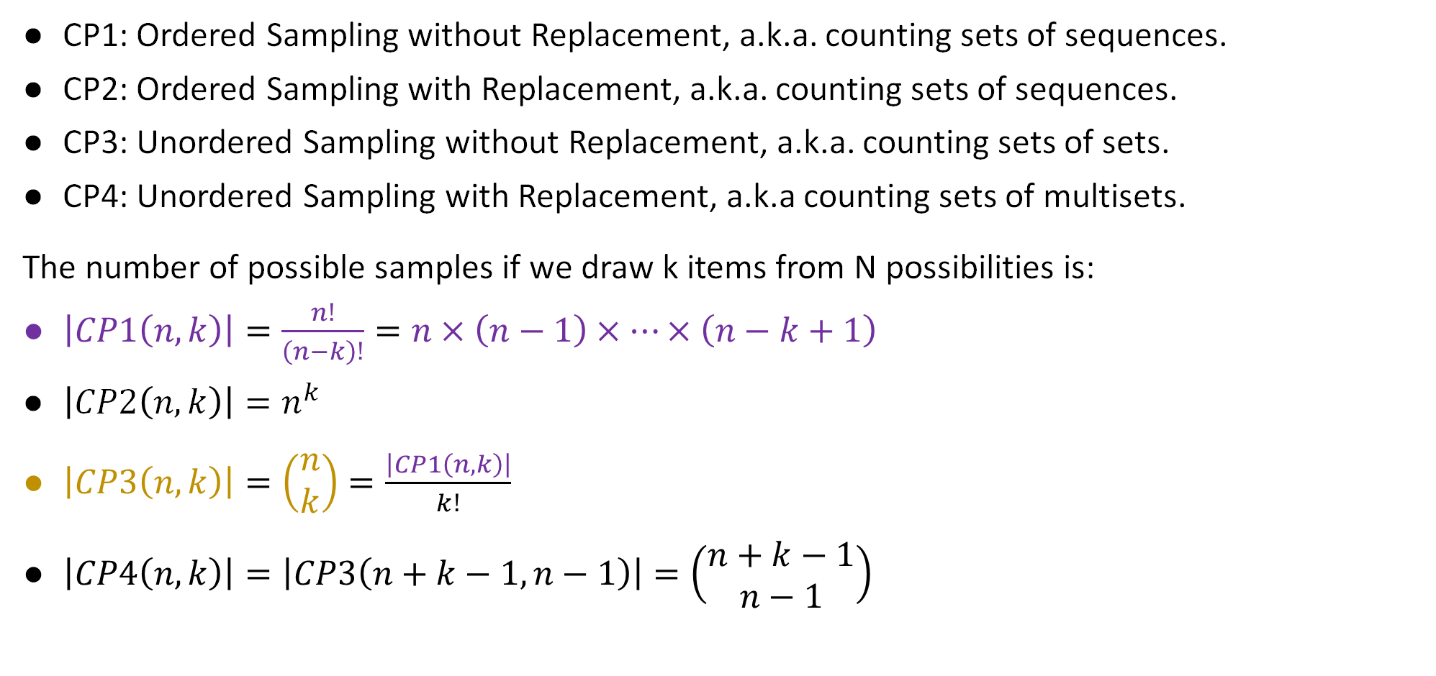
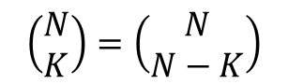
Counting Problems Summary
CP1: Ordered Sampling without Replacement, a.k.a. counting sets of sequences.
CP2: Ordered Sampling with Replacement, a.k.a. counting sets of sequences.
CP3: Unordered Sampling without Replacement, a.k.a. counting sets of sets.
CP4: Unordered Sampling with Replacement, a.k.a counting sets of multisets.
The number of possible samples if we draw k items from N possibilities is:
$\left|CP1\left(n,k\right)\right|=\frac{n!}{\left(n−k\right)!}=n×\left(n−1\right)×…×\left(n−k+1\right)$
$\left|CP2\left(n,k\right)\right|=n^{k}$
$\left|CP3\left(n,k\right)\right|=\left(\begin{matrix}n \\ k\end{matrix}\right)=\frac{\left|CP1\left(n,k\right)\right|}{k!}$
$\left|CP4\left(n,k\right)\right|=\left|CP3\left(n+k−1,n−1\right)\right|=\left(\begin{matrix}n+k−1 \\ n−1\end{matrix}\right)$
If we count the positions of the separators
$$=\left|CP3\left(n+k−1,k\right)\right| =\left(\begin{matrix}n+k−1 \\ k\end{matrix}\right)$$
If we count the positions of the non-separators
From hidden slide
$$\left(\begin{matrix}N \\ K\end{matrix}\right)=\left(\begin{matrix}N \\ N−K\end{matrix}\right)$$

Slide 10
Probability Spaces
Introduction
Probability and CS70
Probability Spaces
Event Probability
Event Probability Examples
Counting Sample Points
Counting Weighted Sample Points
Poker Hands
Balls and Bins
The Birthday Paradox
Summary of Examples
The Monty Hall Problem
Simple Analysis
Sample Space Analysis
Lecture 15, CS70 Fall 2025

Slide 11
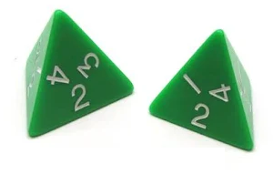
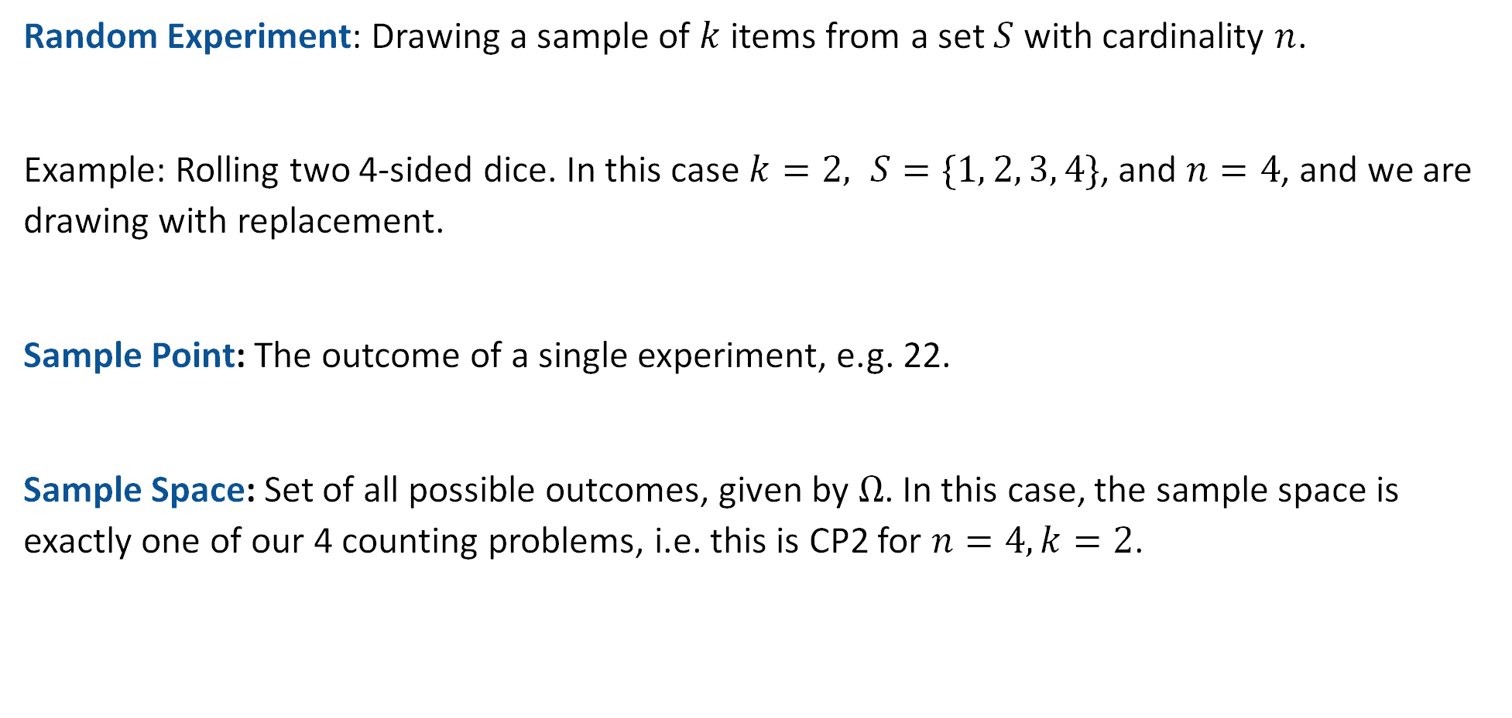
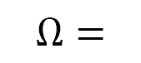
Random Experiment, Sample Point, Sample Space
Random Experiment: Drawing a sample of $k$ items from a set $S$ with cardinality $n$.
Example: Rolling two 4-sided dice. In this case $k=2, S=\{1, 2, 3, 4\}$, and $n=4$, and we are drawing with replacement.
Sample Point: The outcome of a single experiment, e.g. 22.
Sample Space: Set of all possible outcomes, given by $Ω$. In this case, the sample space is exactly one of our 4 counting problems, i.e. this is CP2 for $n=4, k=2$.
11 12 13 14
21 22 23 24
31 32 33 34
41 42 43 44
$$Ω=$$

Slide 12
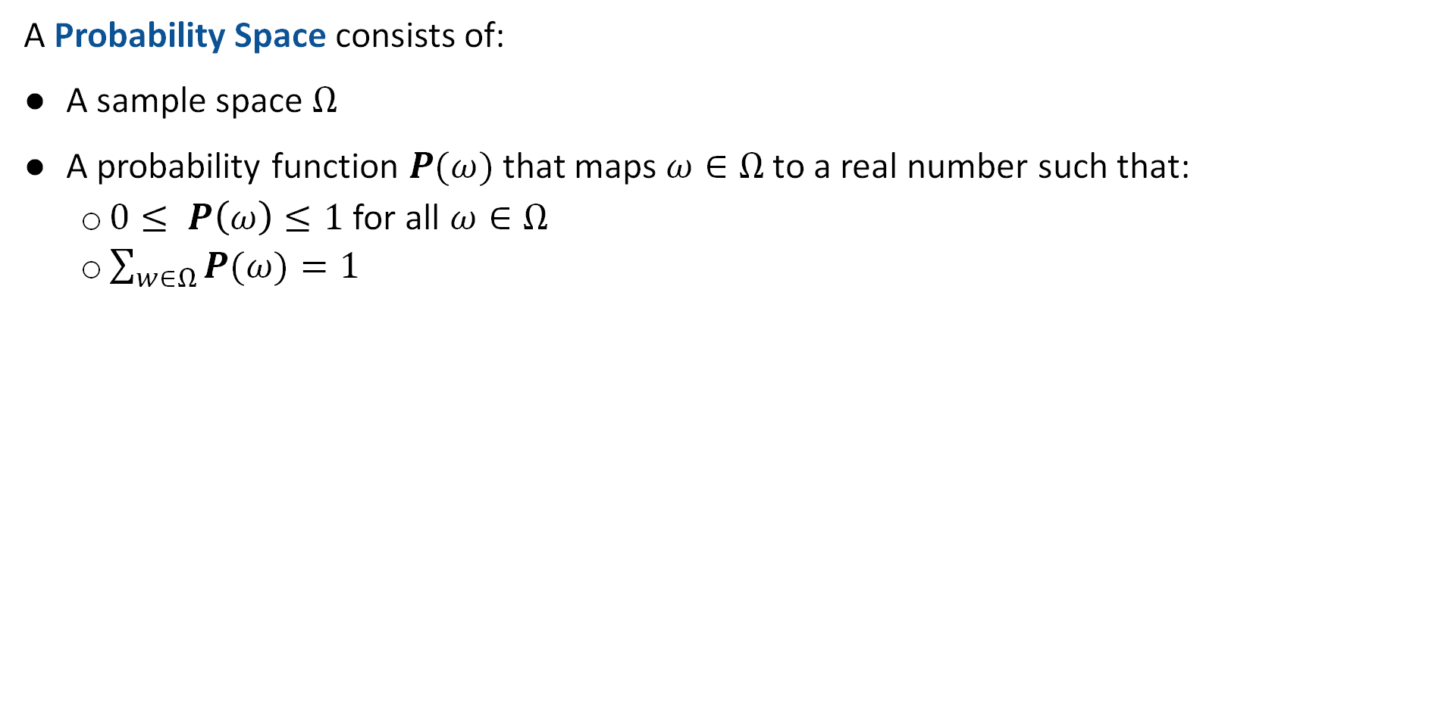
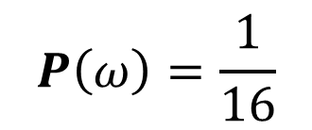
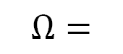
Probability Space
A Probability Space consists of:
A sample space $Ω$
A probability function $P(ω)$ that maps $ω∈Ω$ to a real number such that:
$0≤ P\left(ω\right)≤1$ for all $ω∈Ω$
$\sum_{w∈Ω}{P(ω)}=1$
Example: Rolling two fair 4-sided dice. In this case, $Ω$ and $P$ are:
11 12 13 14
21 22 23 24
31 32 33 34
41 42 43 44
$$P\left(ω\right)=\frac{1}{16}$$
$$Ω=$$
This is a “uniform probability space”.

Slide 13
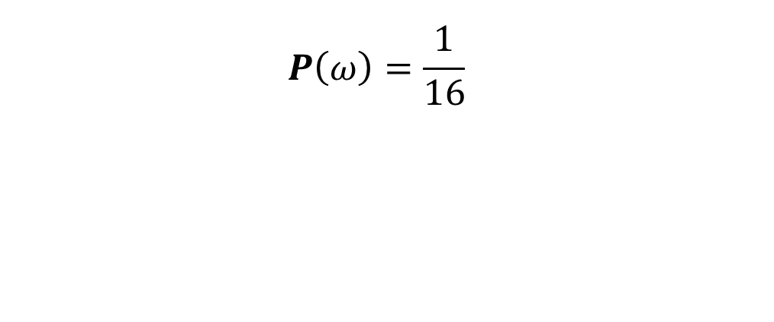
Tree Diagram for a Uniform Probability Space
1/4
$$P\left(ω\right)=\frac{1}{16}$$
4
1/4
3
4
1/4
2
1/4
1
1/4
1/4
4
1/4
3
3
1/4
1/4
2
1/4
Can also think about die rolls as a tree of possibilities.
First level is the first roll.
Second level is the second roll.
1
1/4
1/4
4
1/4
3
2
1/4
2
1/4
1/4
1
1/4
4
1/4
3
1
1/4
2
1/4
1

Slide 14

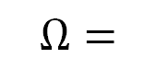
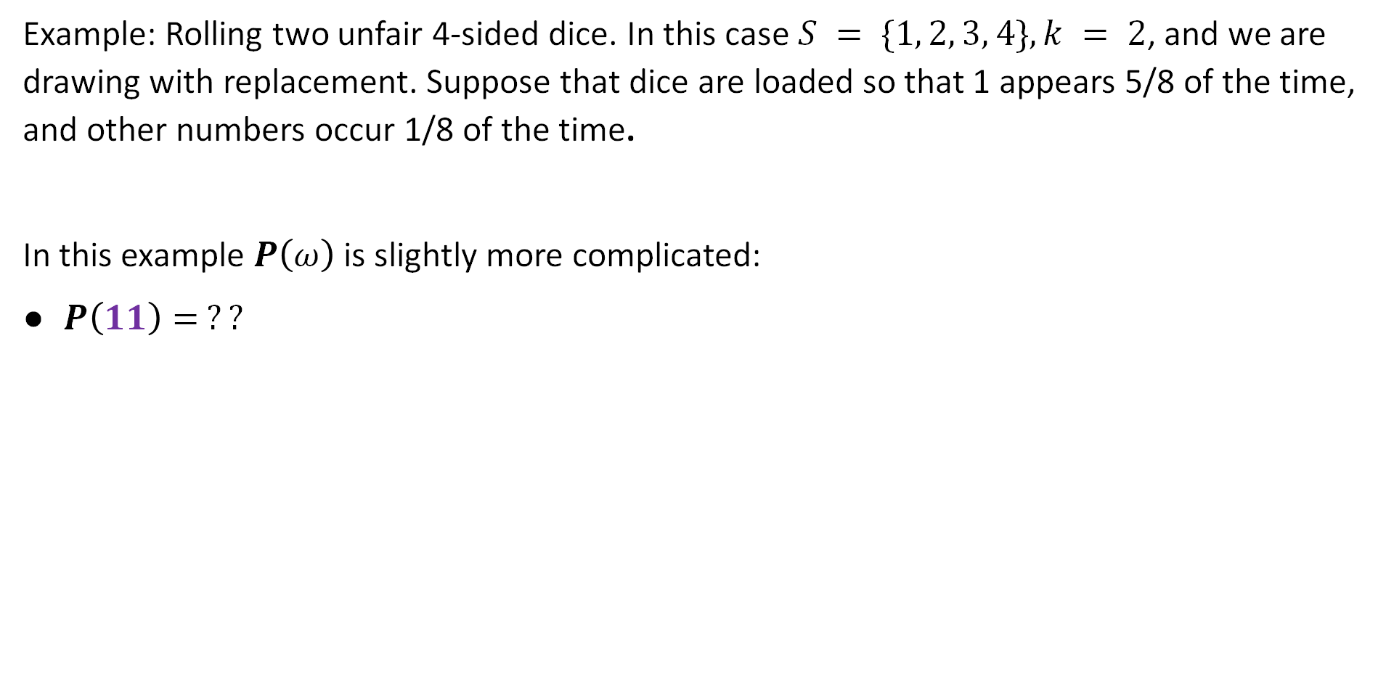
Example Non-Uniform Probability Space
Example: Rolling two unfair 4-sided dice. In this case $S = \{1, 2, 3, 4\}, k = 2$, and we are drawing with replacement. Suppose that dice are loaded so that 1 appears 5/8 of the time, and other numbers occur 1/8 of the time.
In this example $P\left(ω\right)$ is slightly more complicated:
$P\left(11\right)= ??$
https://joshh.ug/B
11 12 13 14
21 22 23 24
31 32 33 34
41 42 43 44
$$Ω=$$

Slide 15

Example Non-Uniform Probability Space
Example: Rolling two unfair 4-sided dice. In this case $S = \{1, 2, 3, 4\}, k = 2$, and we are drawing with replacement. Suppose that dice are loaded so that 1 appears 5/8 of the time, and other numbers occur 1/8 of the time.
In this example $P\left(ω\right)$ is slightly more complicated:
$P\left(11\right)=25/64$
11 12 13 14
21 22 23 24
31 32 33 34
41 42 43 44
$$Ω=$$
This is a non-uniform probability space.

Slide 16
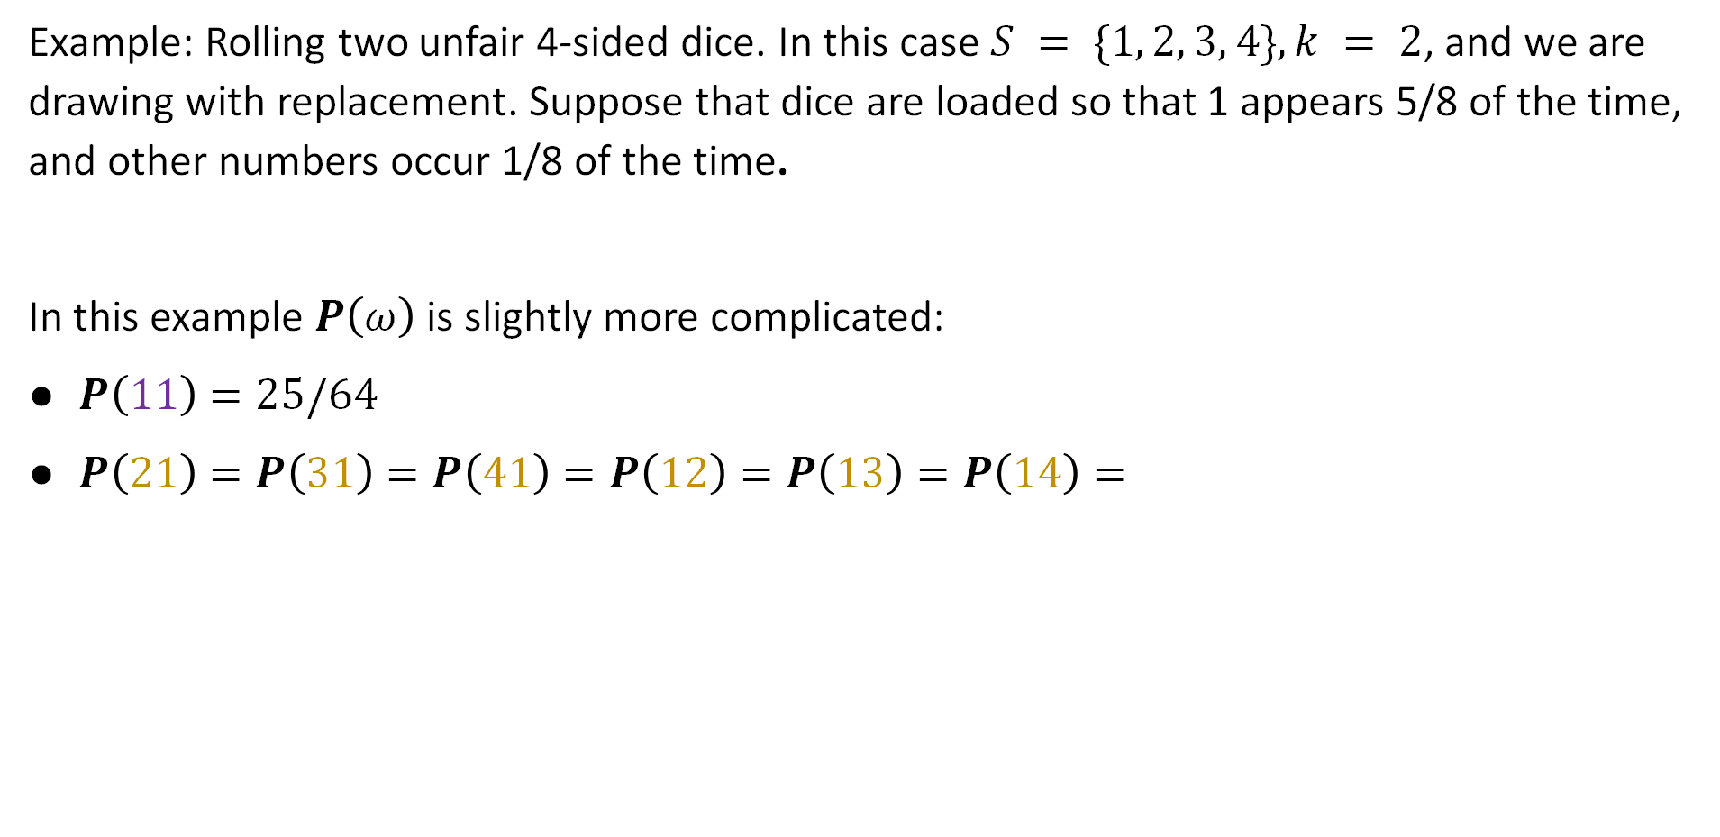
Example Non-Uniform Probability Space
Example: Rolling two unfair 4-sided dice. In this case $S = \{1, 2, 3, 4\}, k = 2$, and we are drawing with replacement. Suppose that dice are loaded so that 1 appears 5/8 of the time, and other numbers occur 1/8 of the time.
In this example $P\left(ω\right)$ is slightly more complicated:
$P\left(11\right)=25/64$
$P\left(21\right)=P\left(31\right)=P\left(41\right)=P\left(12\right)=P\left(13\right)=P\left(14\right)=$
11 12 13 14
21 22 23 24
31 32 33 34
41 42 43 44
$$Ω=$$
This is a non-uniform probability space.

Slide 17

Example Non-Uniform Probability Space
Example: Rolling two unfair 4-sided dice. In this case $S = \{1, 2, 3, 4\}, k = 2$, and we are drawing with replacement. Suppose that dice are loaded so that 1 appears 5/8 of the time, and other numbers occur 1/8 of the time.
In this example $P\left(ω\right)$ is slightly more complicated:
$P\left(11\right)=25/64$
$P\left(21\right)=P\left(31\right)=P\left(41\right)=P\left(12\right)=P\left(13\right)=P\left(14\right)=5/64$
11 12 13 14
21 22 23 24
31 32 33 34
41 42 43 44
$$Ω=$$
This is a non-uniform probability space.

Slide 18
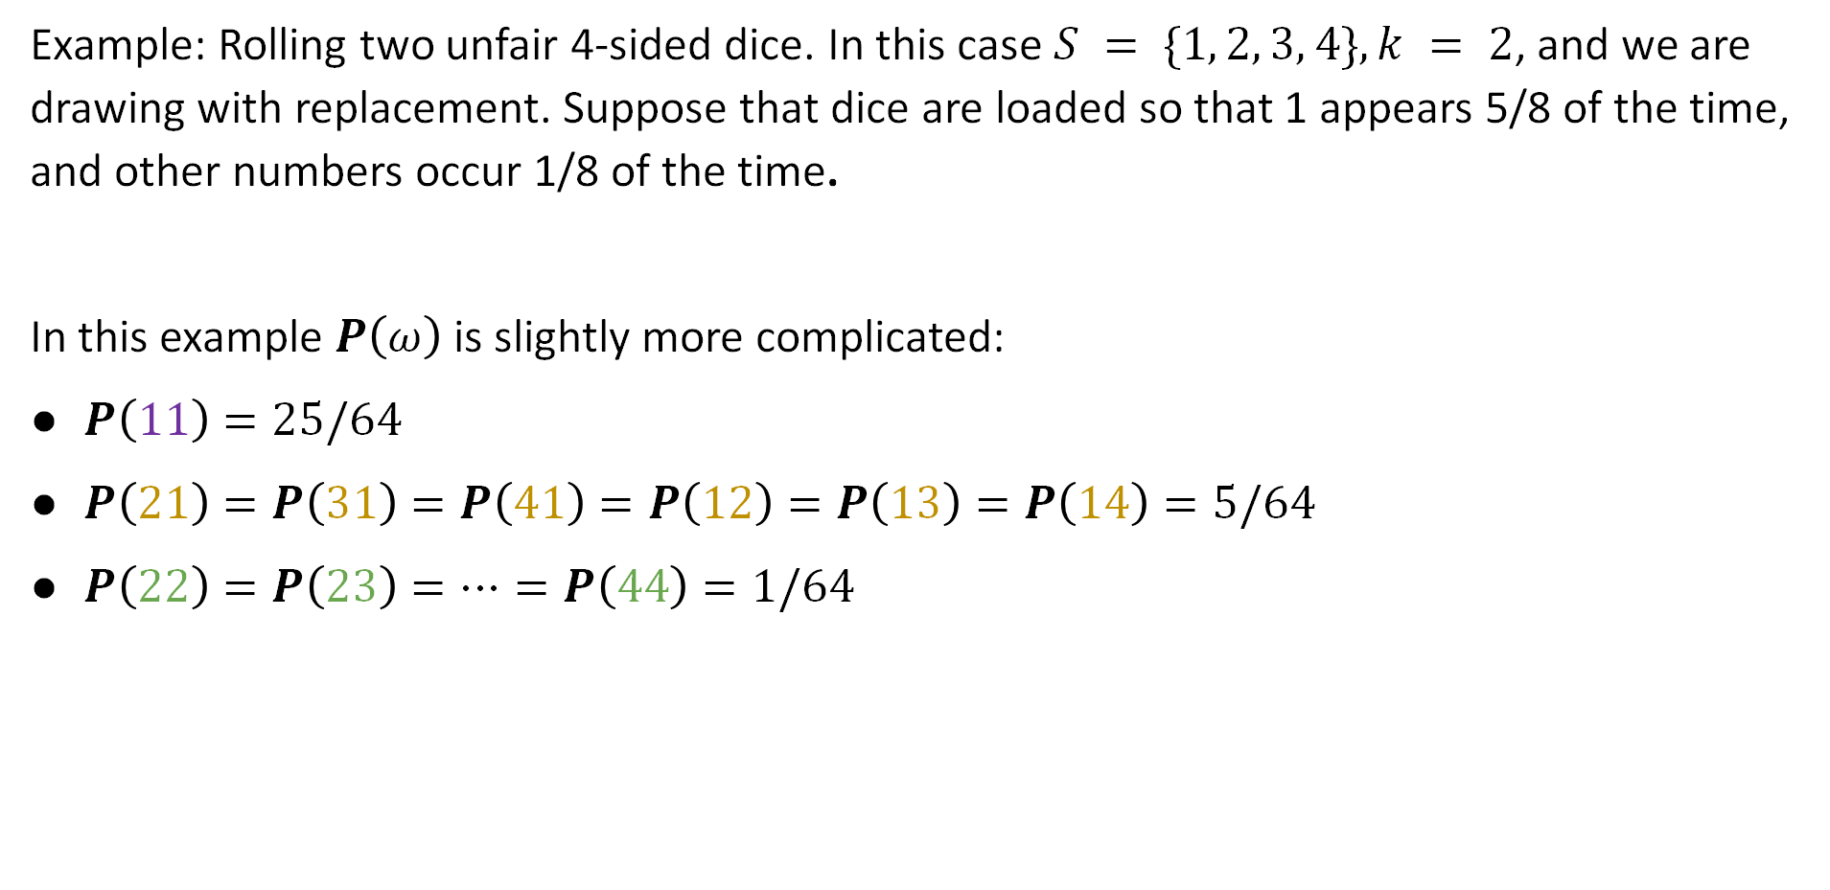
Another Example Probability Space
Example: Rolling two unfair 4-sided dice. In this case $S = \{1, 2, 3, 4\}, k = 2$, and we are drawing with replacement. Suppose that dice are loaded so that 1 appears 5/8 of the time, and other numbers occur 1/8 of the time.
In this example $P\left(ω\right)$ is slightly more complicated:
$P\left(11\right)=25/64$
$P\left(21\right)=P\left(31\right)=P\left(41\right)=P\left(12\right)=P\left(13\right)=P\left(14\right)=5/64$
$P\left(22\right)=P\left(23\right)=…=P\left(44\right)=1/64$
11 12 13 14
21 22 23 24
31 32 33 34
41 42 43 44
$$Ω=$$
This is a non-uniform probability space.

Slide 19
Tree Diagram for a Non-Uniform Probability Space
4
1/8
3
1/8
A tree diagram gives a somewhat more formal explanation of the probability of each outcome.
1/8
2
5/8
1

Slide 20
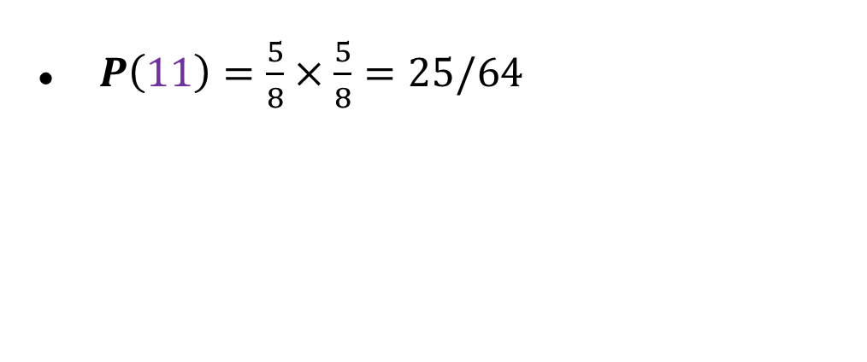
Tree Diagram for a Non-Uniform Probability Space
$P\left(11\right)=\frac{5}{8}×\frac{5}{8}=25/64$
4
1/8
3
1/8
A tree diagram gives a somewhat more formal explanation of the probability of each outcome.
Here, we can multiply the probabilities together because the dice rolls are independent. More on this in a later lecture.
1/8
2
5/8
1
5/8
1

Slide 21
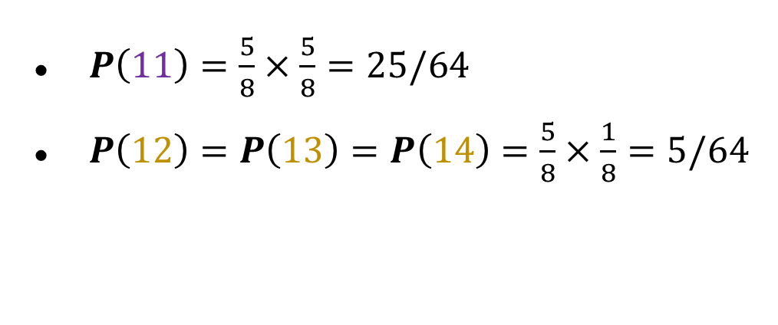
Tree Diagram for a Non-Uniform Probability Space
$P\left(11\right)=\frac{5}{8}×\frac{5}{8}=25/64$
$P\left(12\right)=P\left(13\right)=P\left(14\right)=\frac{5}{8}×\frac{1}{8}=5/64$
4
1/8
3
1/8
A tree diagram gives a somewhat more formal explanation of the probability of each outcome.
Here, we can multiply the probabilities together because the dice rolls are independent. More on this in a later lecture.
1/8
2
5/8
1/8
4
1/8
3
1
1/8
2
5/8
1

Slide 22
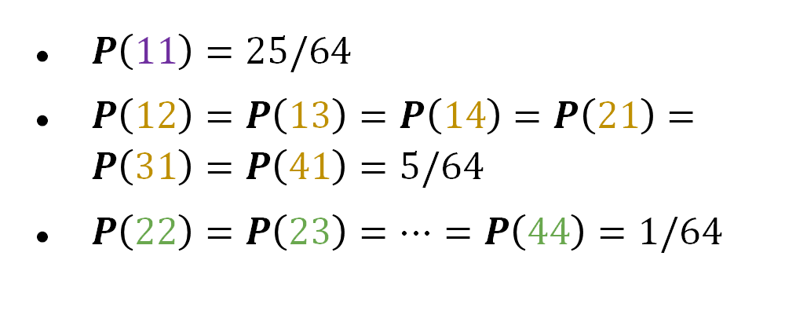
Tree Diagram for a Non-Uniform Probability Space
1/8
$P\left(11\right)=25/64$
$P\left(12\right)=P\left(13\right)=P\left(14\right)=P\left(21\right)=P\left(31\right)=P\left(41\right)=5/64$
$P\left(22\right)=P\left(23\right)=…=P\left(44\right)=1/64$
4
1/8
3
4
1/8
2
5/8
1
1/8
1/8
4
1/8
3
3
1/8
1/8
2
5/8
A tree diagram gives a somewhat more formal explanation of the probability of each outcome.
Here, we can multiply the probabilities together because the dice rolls are independent. More on this in a later lecture.
1
1/8
1/8
4
1/8
3
2
1/8
2
5/8
5/8
1
1/8
4
1/8
3
1
1/8
2
5/8
1

Slide 23
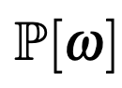
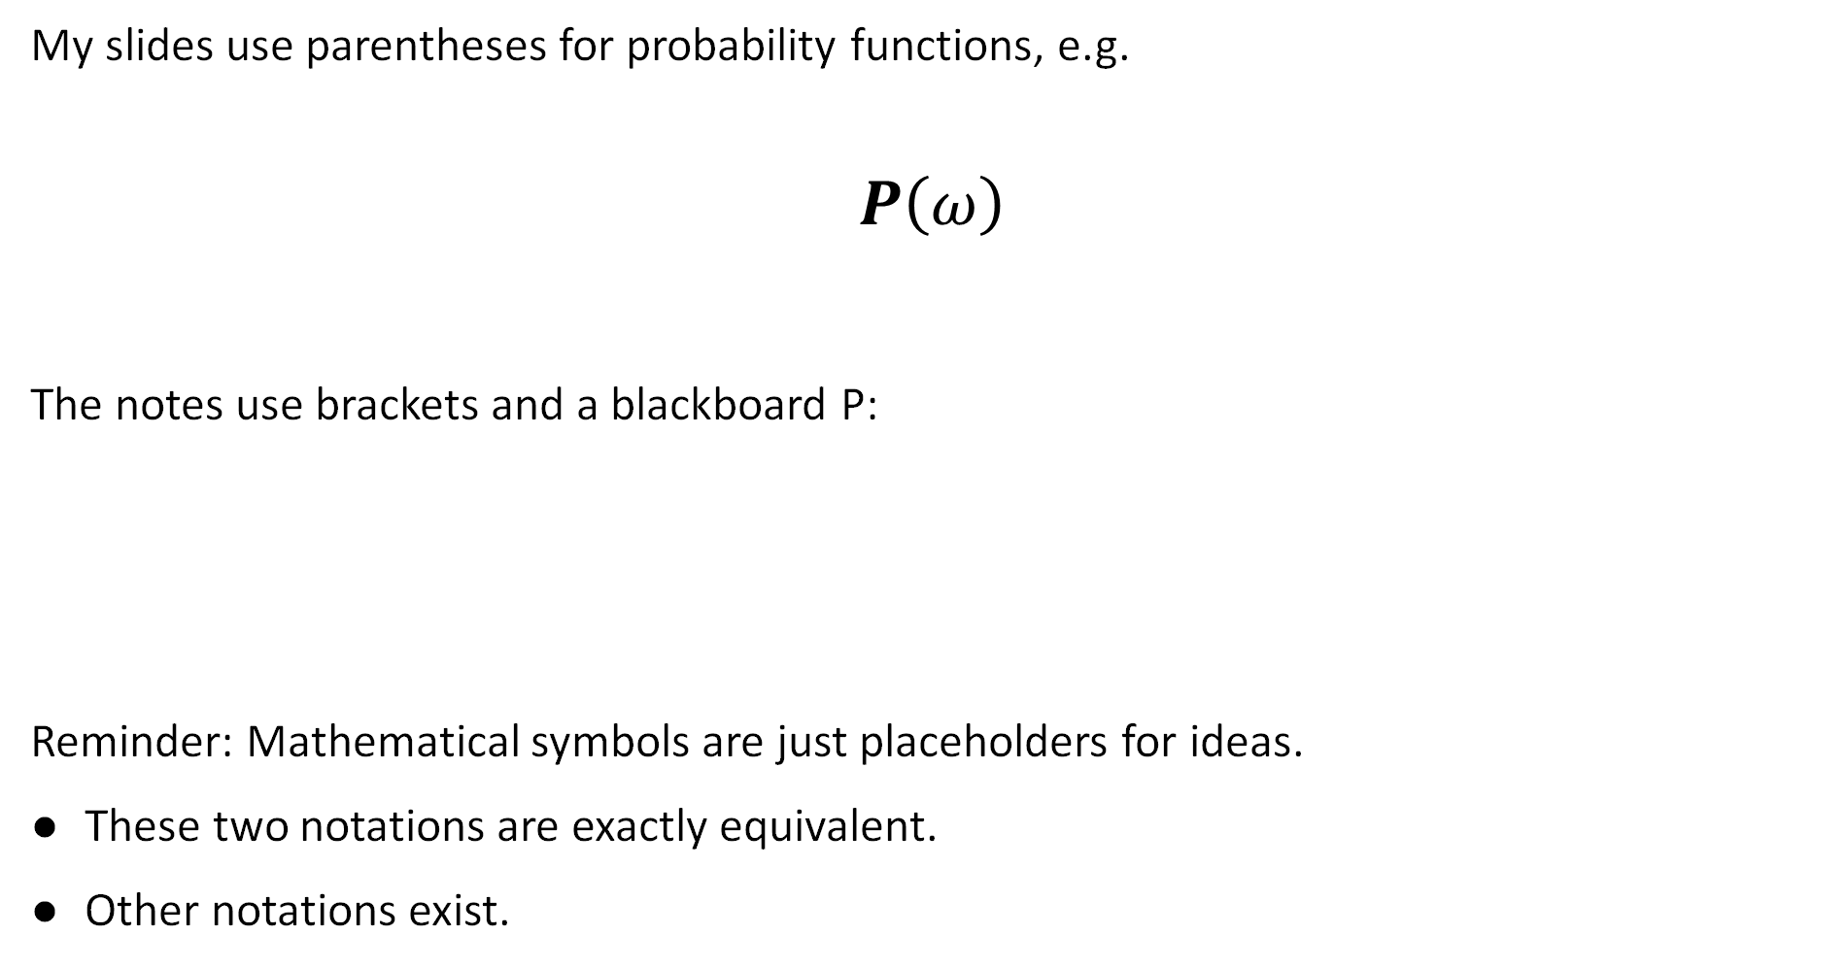
Reflection on Notation
My slides use parentheses for probability functions, e.g.
$$P\left(ω\right)$$
The notes use brackets and a blackboard P:
Reminder: Mathematical symbols are just placeholders for ideas.
These two notations are exactly equivalent.
Other notations exist.

Slide 24
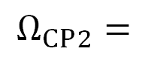
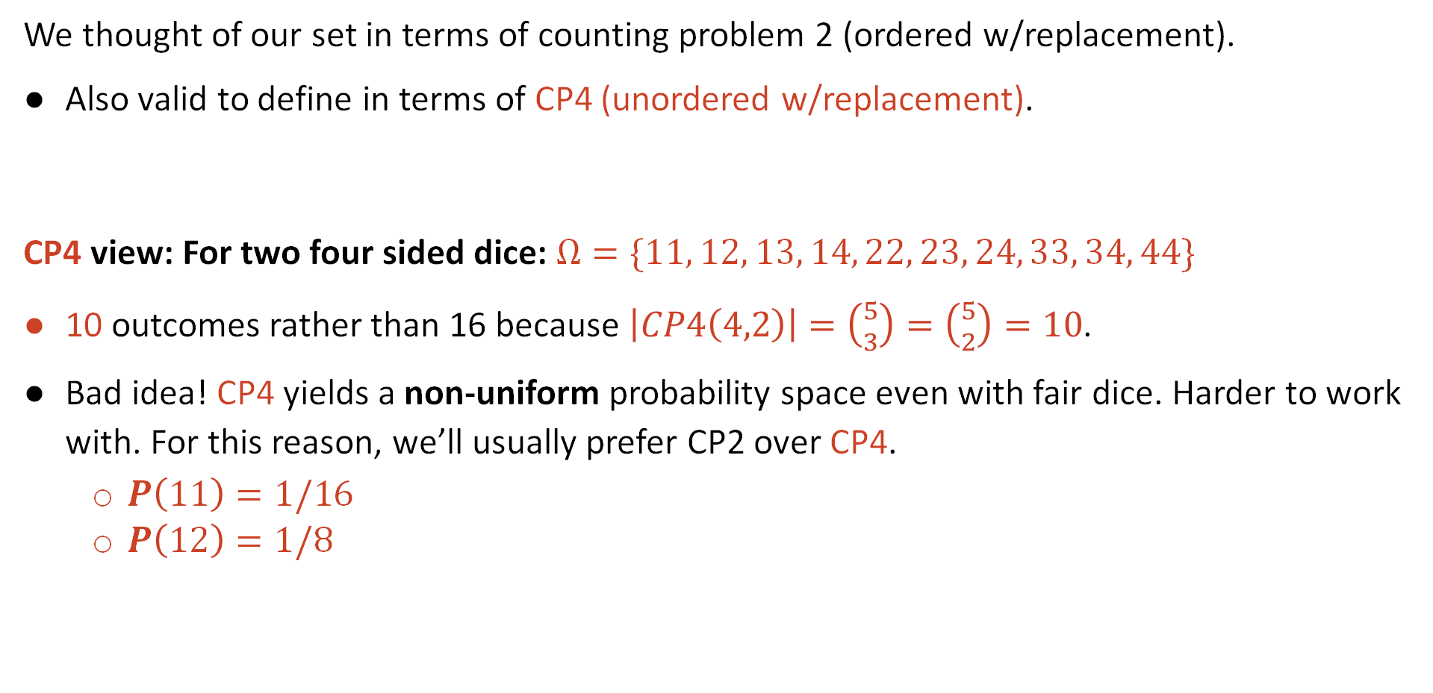
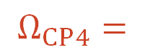
Reflection on Problem Framing: CP2 vs. CP4
We thought of our set in terms of counting problem 2 (ordered w/replacement).
Also valid to define in terms of CP4 (unordered w/replacement).
CP4 view: For two four sided dice: $Ω=\{11, 12, 13, 14, 22, 23, 24, 33, 34, 44\}$
10 outcomes rather than 16 because $\left|CP4\left(4,2\right)\right|=\left({5 \atop 3}\right)=\left({5 \atop 2}\right)=10$.
Bad idea! CP4 yields a non-uniform probability space even with fair dice. Harder to work with. For this reason, we’ll usually prefer CP2 over CP4.
$P\left(11\right)=1/16$
$P\left(12\right)=1/8$
11 12 13 14
21 22 23 24
31 32 33 34
41 42 43 44
11 12 13 14
22 23 24
33 34
44
$$Ω_{CP2}=$$
$$Ω_{CP4}=$$

Slide 25
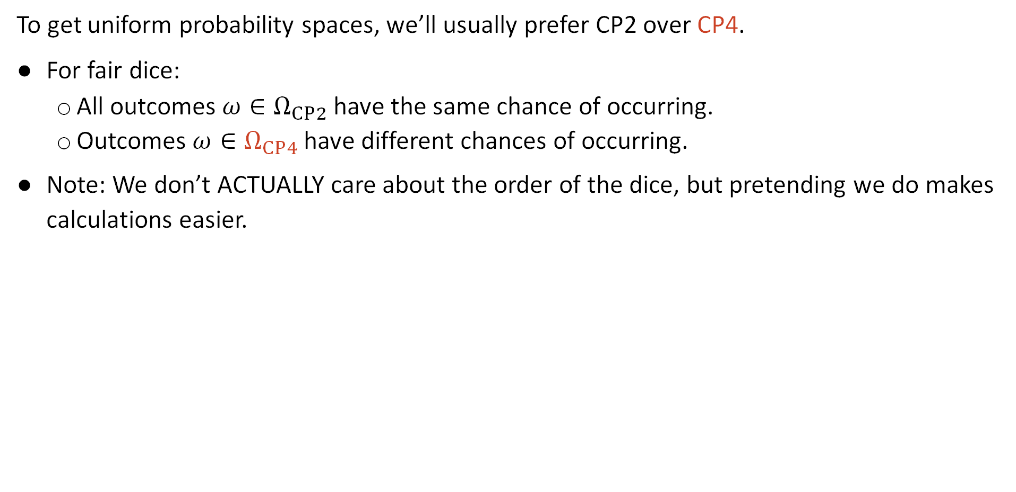
Reflection on Problem Framing: CP2 vs. CP4
To get uniform probability spaces, we’ll usually prefer CP2 over CP4.
For fair dice:
All outcomes $ω∈Ω_{CP2}$ have the same chance of occurring.
Outcomes $ω∈Ω_{CP4}$ have different chances of occurring.
Note: We don’t ACTUALLY care about the order of the dice, but pretending we do makes calculations easier.
CP2 Framing
CP4 Framing
11 12 13 14
21 22 23 24
31 32 33 34
41 42 43 44
11 12 13 14
22 23 24
33 34
44
$$Ω_{CP2}=$$
$$Ω_{CP4}=$$

Slide 26
Event Probability
Introduction
Probability and CS70
Probability Spaces
Event Probability
Event Probability Examples
Counting Sample Points
Counting Weighted Sample Points
Poker Hands
Balls and Bins
The Birthday Paradox
Summary of Examples
The Monty Hall Problem
Simple Analysis
Sample Space Analysis
Lecture 15, CS70 Fall 2025

Slide 27
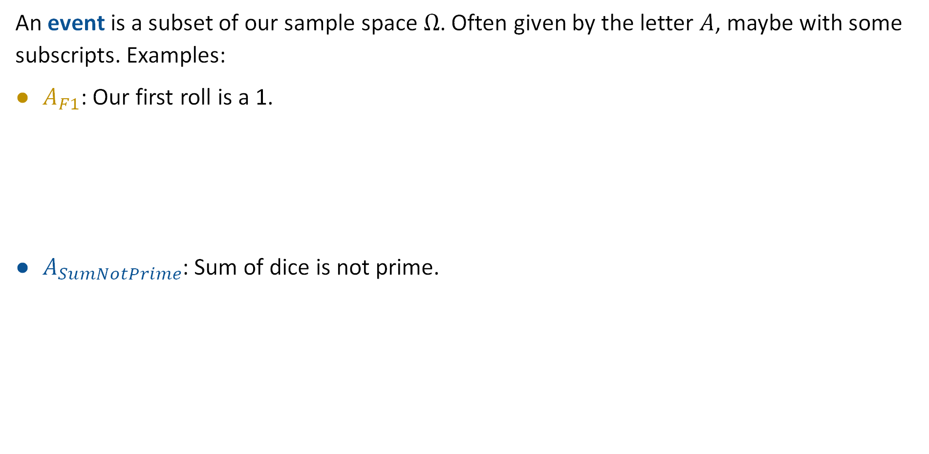
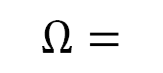
Event
An event is a subset of our sample space $Ω$. Often given by the letter $A$, maybe with some subscripts. Examples:
$A_{F1}$: Our first roll is a 1.
$A_{SumNotPrime}$: Sum of dice is not prime.
11 12 13 14
21 22 23 24
31 32 33 34
41 42 43 44
$$Ω=$$
$$A_{F1}=\{11, 12, 13, 14\}$$
11 12 13 14
21 22 23 24
31 32 33 34
41 42 43 44
$$Ω=$$
$$A_{SumNotPrime}=\{13, 22, 31, 24, 33, 43, 44\}$$

Slide 28
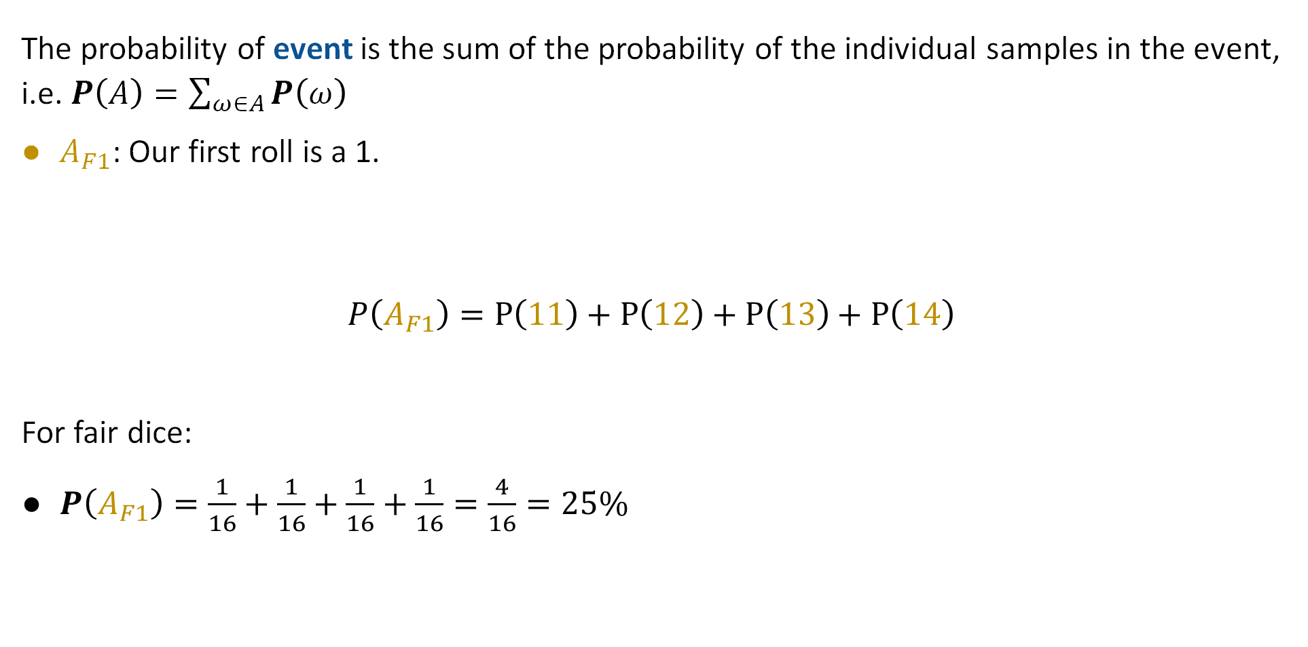
Event
The probability of event is the sum of the probability of the individual samples in the event, i.e. $P\left(A\right)=\sum_{ω∈A}{P\left(ω\right)}$
$A_{F1}$: Our first roll is a 1.
$$P\left(A_{F1}\right)=P\left(11\right)+P\left(12\right)+P\left(13\right)+P\left(14\right)$$
For fair dice:
$P\left(A_{F1}\right)=\frac{1}{16}+\frac{1}{16}+\frac{1}{16}+\frac{1}{16}=\frac{4}{16}=25\%$
11 12 13 14
21 22 23 24
31 32 33 34
41 42 43 44
$$Ω=$$
$$A_{F1}=\{11, 12, 13, 14\}$$

Slide 29
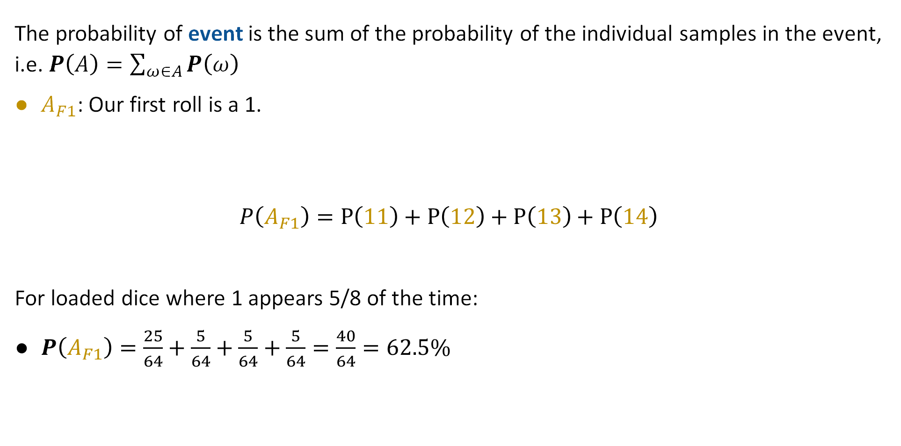
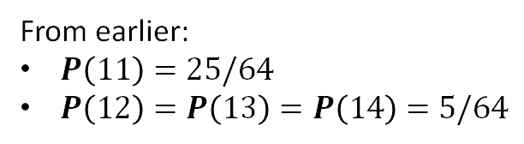
Event
The probability of event is the sum of the probability of the individual samples in the event, i.e. $P\left(A\right)=\sum_{ω∈A}{P\left(ω\right)}$
$A_{F1}$: Our first roll is a 1.
$$P\left(A_{F1}\right)=P\left(11\right)+P\left(12\right)+P\left(13\right)+P\left(14\right)$$
For loaded dice where 1 appears 5/8 of the time:
$P\left(A_{F1}\right)=\frac{25}{64}+\frac{5}{64}+\frac{5}{64}+\frac{5}{64}=\frac{40}{64}=62.5\%$
11 12 13 14
21 22 23 24
31 32 33 34
41 42 43 44
$$Ω=$$
$$A_{F1}=\{11, 12, 13, 14\}$$
From earlier:
$P\left(11\right)=25/64$
$P\left(12\right)=P\left(13\right)=P\left(14\right)=5/64$

Slide 30

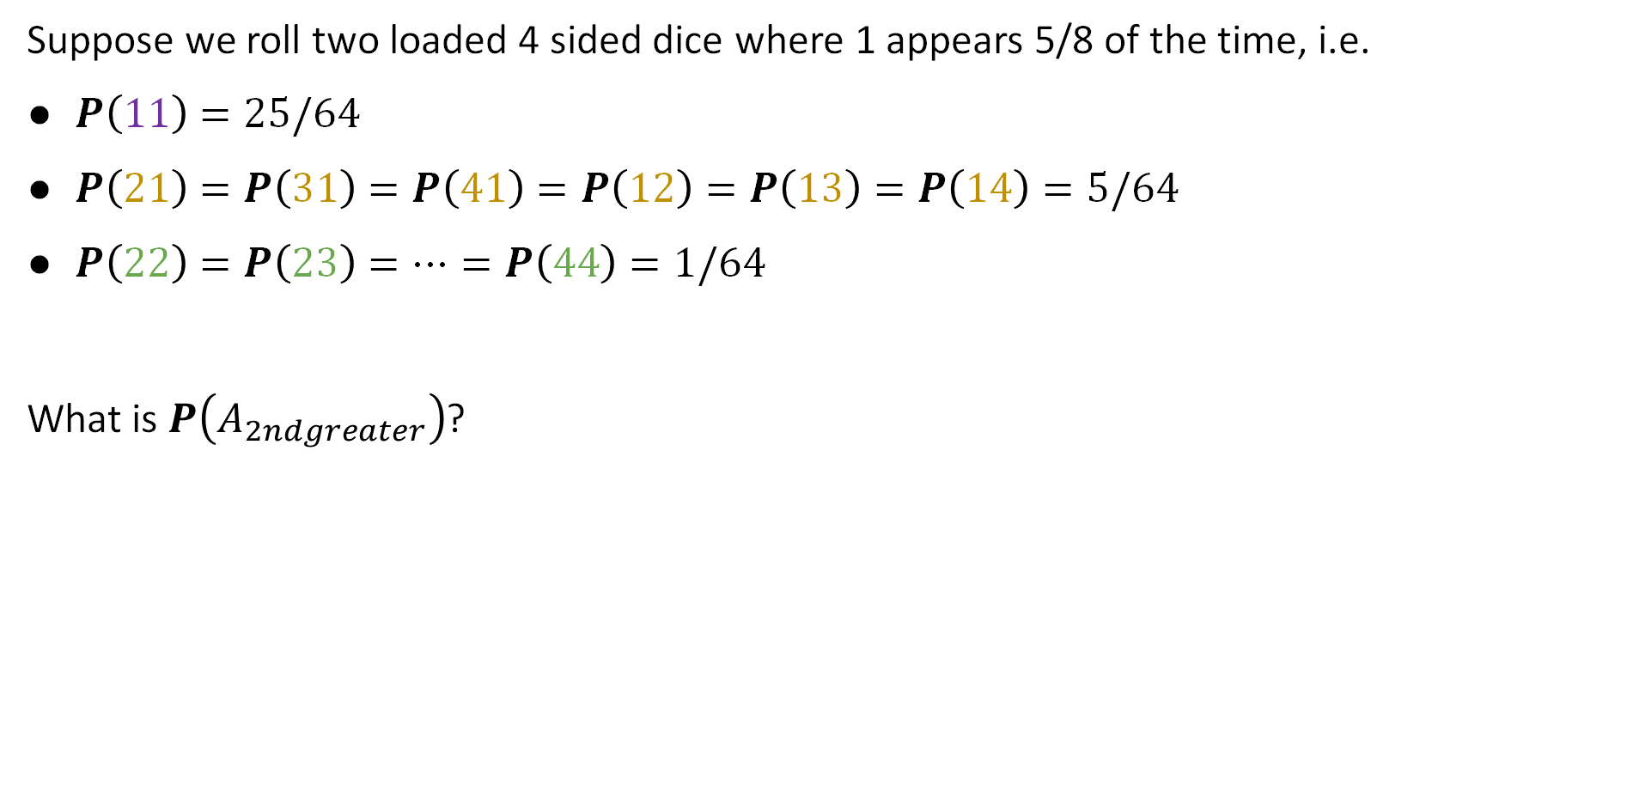
Understanding Check
Suppose we roll two loaded 4 sided dice where 1 appears 5/8 of the time, i.e.
$P\left(11\right)=25/64$
$P\left(21\right)=P\left(31\right)=P\left(41\right)=P\left(12\right)=P\left(13\right)=P\left(14\right)=5/64$
$P\left(22\right)=P\left(23\right)=…=P\left(44\right)=1/64$
What is $P\left(A_{2ndgreater}\right)$?
https://joshh.ug/C
11 12 13 14
21 22 23 24
31 32 33 34
41 42 43 44
$$Ω=$$

Slide 31
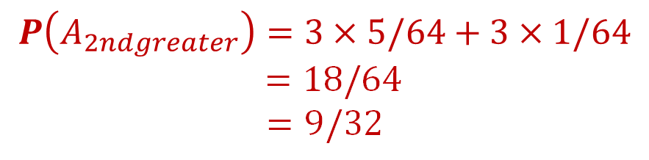
Understanding Check
Suppose we roll two loaded 4 sided dice where 1 appears 5/8 of the time, i.e.
$P\left(11\right)=25/64$
$P\left(21\right)=P\left(31\right)=P\left(41\right)=P\left(12\right)=P\left(13\right)=P\left(14\right)=5/64$
$P\left(22\right)=P\left(23\right)=…=P\left(44\right)=1/64$
What is $P\left(A_{2ndgreater}\right)$?
11 12 13 14
21 22 23 24
31 32 33 34
41 42 43 44
$$P\left(A_{2ndgreater}\right)=3×5/64+3×1/64$$
$$=18/64$$
$$=9/32$$
$$Ω=$$

Slide 32
Counting Sample Points
Introduction
Probability and CS70
Probability Spaces
Event Probability
Event Probability Examples
Counting Sample Points
Counting Weighted Sample Points
Poker Hands
Balls and Bins
The Birthday Paradox
Summary of Examples
The Monty Hall Problem
Simple Analysis
Sample Space Analysis
Lecture 15, CS70 Fall 2025

Slide 33
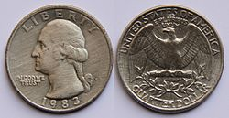
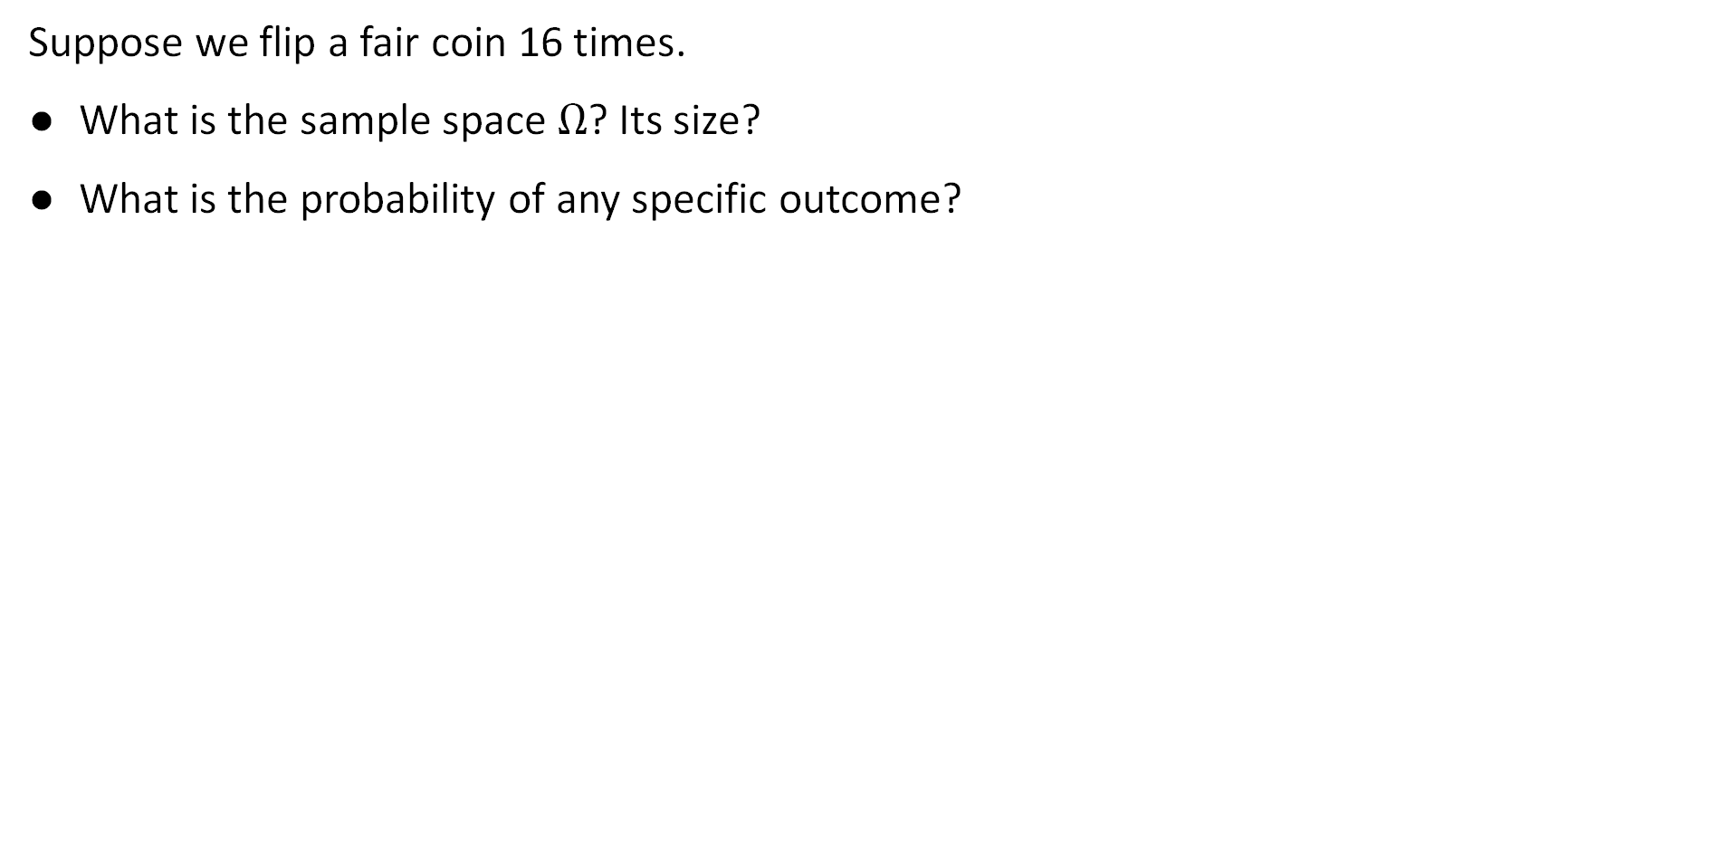
Another Example: Flipping Coins
Suppose we flip a fair coin 16 times.
What is the sample space $Ω$? Its size?
What is the probability of any specific outcome?

Slide 34
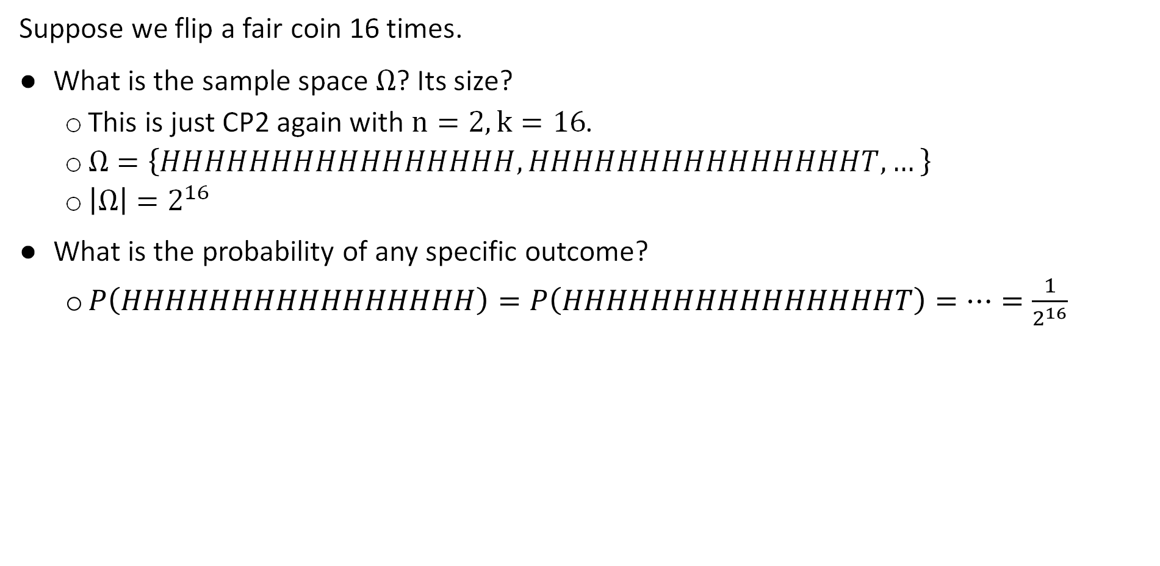
Another Example: Flipping Coins
Suppose we flip a fair coin 16 times.
What is the sample space $Ω$? Its size?
This is just CP2 again with $n=2, k=16$.
$Ω=\left\{HHHHHHHHHHHHHHHH,HHHHHHHHHHHHHHHT, …\right\}$
$\left|Ω\right|=2^{16}$
What is the probability of any specific outcome?
$P\left(HHHHHHHHHHHHHHHH\right)=P\left(HHHHHHHHHHHHHHHT\right)=…=\frac{1}{2^{16}}$

Slide 35
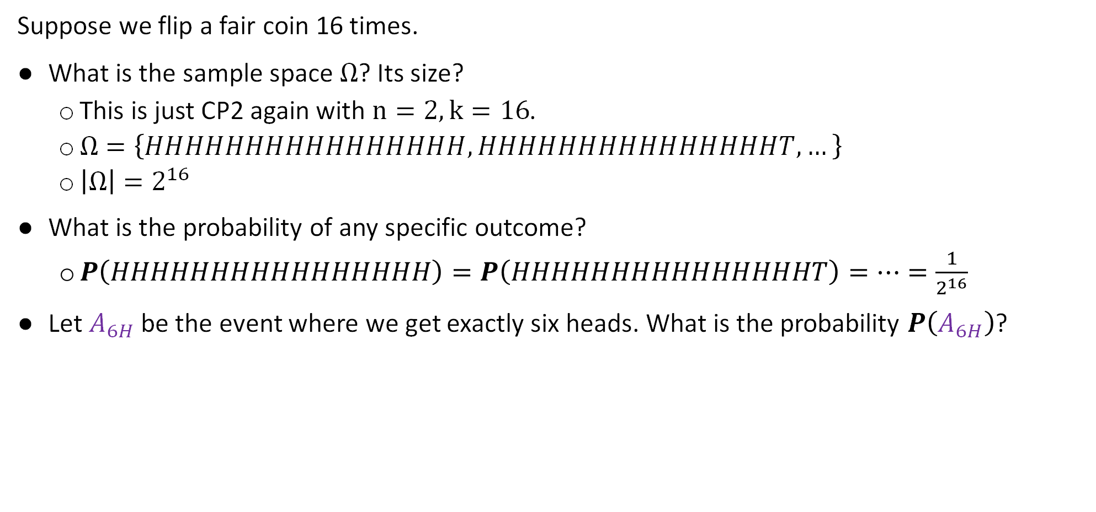
Another Example: Flipping Coins
Suppose we flip a fair coin 16 times.
What is the sample space $Ω$? Its size?
This is just CP2 again with $n=2, k=16$.
$Ω=\left\{HHHHHHHHHHHHHHHH,HHHHHHHHHHHHHHHT, …\right\}$
$\left|Ω\right|=2^{16}$
What is the probability of any specific outcome?
$P\left(HHHHHHHHHHHHHHHH\right)=P\left(HHHHHHHHHHHHHHHT\right)=…=\frac{1}{2^{16}}$
Let $A_{6H}$ be the event where we get exactly six heads. What is the probability $P\left(A_{6H}\right)$?

Slide 36
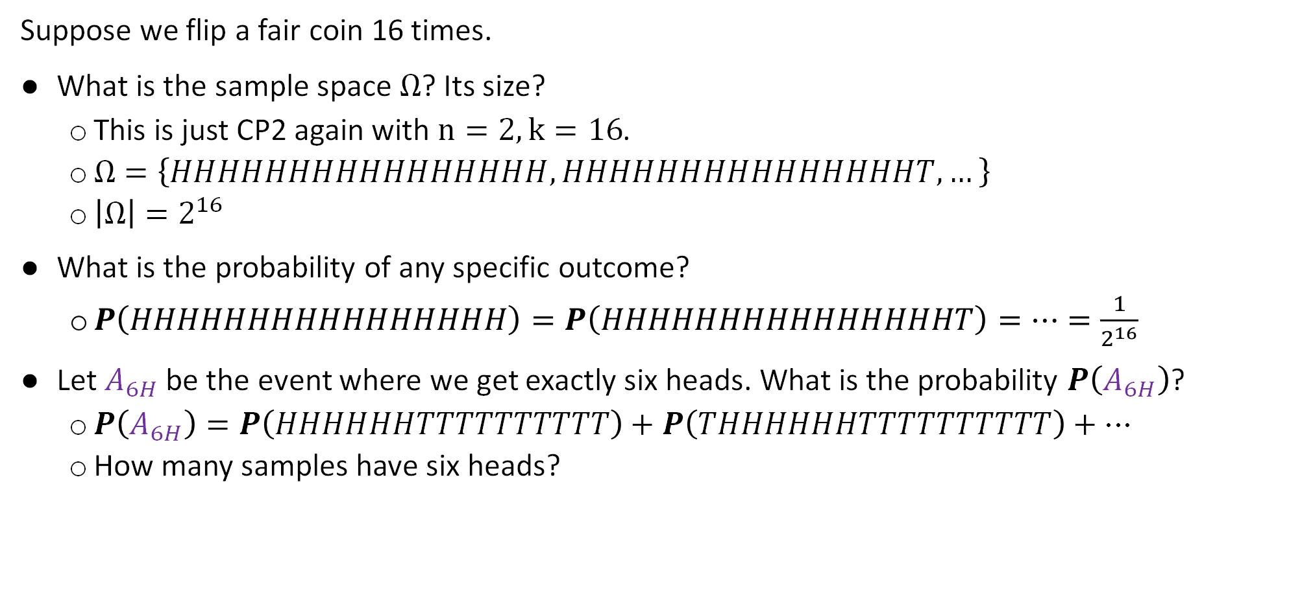
Another Example: Flipping Coins
Suppose we flip a fair coin 16 times.
What is the sample space $Ω$? Its size?
This is just CP2 again with $n=2, k=16$.
$Ω=\left\{HHHHHHHHHHHHHHHH,HHHHHHHHHHHHHHHT, …\right\}$
$\left|Ω\right|=2^{16}$
What is the probability of any specific outcome?
$P\left(HHHHHHHHHHHHHHHH\right)=P\left(HHHHHHHHHHHHHHHT\right)=…=\frac{1}{2^{16}}$
Let $A_{6H}$ be the event where we get exactly six heads. What is the probability $P\left(A_{6H}\right)$?
$P\left(A_{6H}\right)=P\left(HHHHHHTTTTTTTTTT\right)+P\left(THHHHHHTTTTTTTTTT\right)+…$
How many samples have six heads?

Slide 37
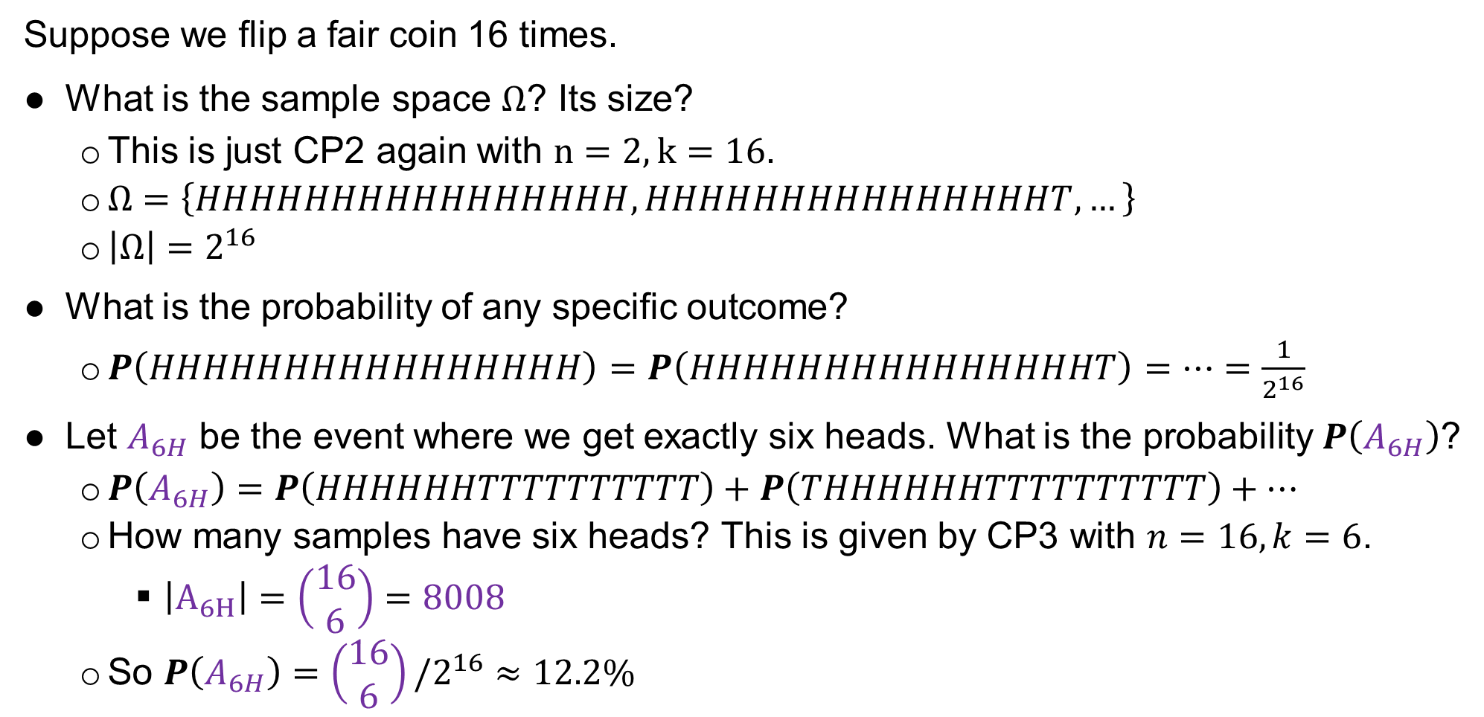
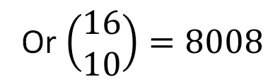
Another Example: Flipping Coins
Suppose we flip a fair coin 16 times.
What is the sample space $Ω$? Its size?
This is just CP2 again with $n=2, k=16$.
$Ω=\left\{HHHHHHHHHHHHHHHH,HHHHHHHHHHHHHHHT, …\right\}$
$\left|Ω\right|=2^{16}$
What is the probability of any specific outcome?
$P\left(HHHHHHHHHHHHHHHH\right)=P\left(HHHHHHHHHHHHHHHT\right)=…=\frac{1}{2^{16}}$
Let $A_{6H}$ be the event where we get exactly six heads. What is the probability $P\left(A_{6H}\right)$?
$P\left(A_{6H}\right)=P\left(HHHHHHTTTTTTTTTT\right)+P\left(THHHHHHTTTTTTTTTT\right)+…$
How many samples have six heads? This is given by CP3 with $n=16, k=6$.
$\left|A_{6H}\right|=\left(\begin{matrix}16 \\ 6\end{matrix}\right)=8008$
So $P\left(A_{6H}\right)=$ $\left(\begin{matrix}16 \\ 6\end{matrix}\right)/2^{16}≈12.2\%$
Or $\left(\begin{matrix}16 \\ 10\end{matrix}\right)=8008$

Slide 38
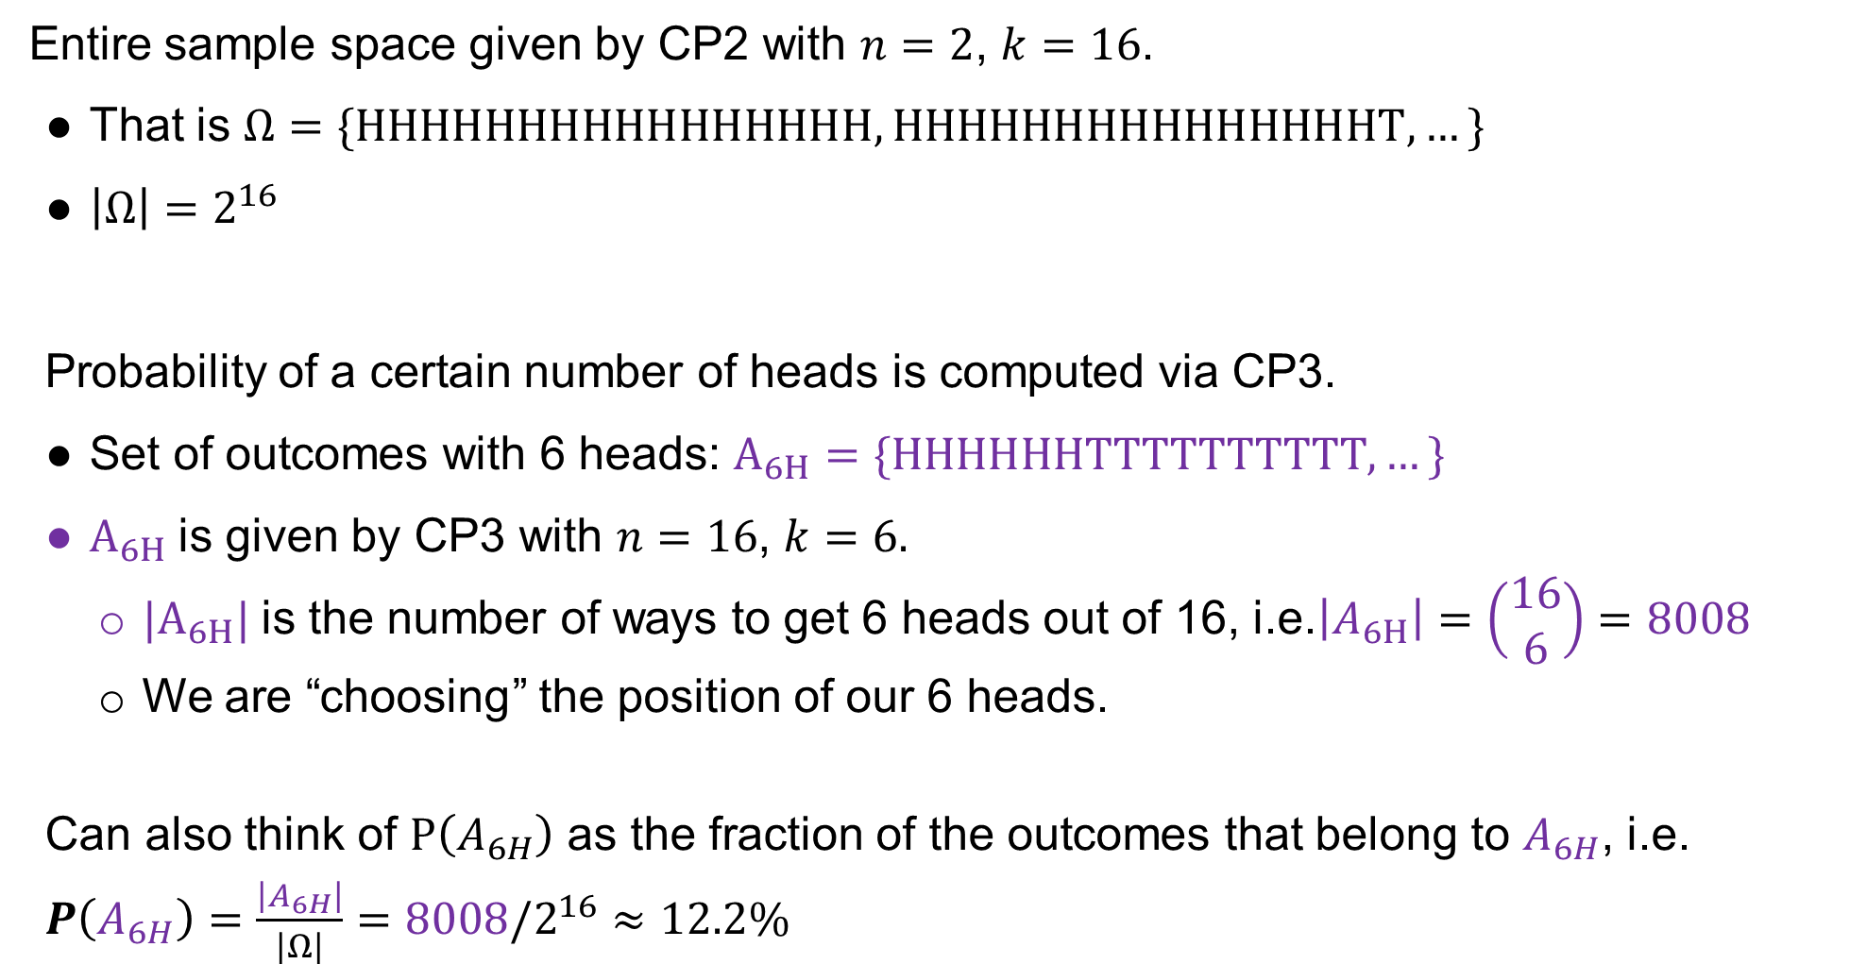
Sixteen Coins Summary
Entire sample space given by CP2 with $n=2$, $k=16$.
That is $Ω=\{HHHHHHHHHHHHHHHH,HHHHHHHHHHHHHHHT, …\}$
$\left|Ω\right|=2^{16}$
Probability of a certain number of heads is computed via CP3.
Set of outcomes with 6 heads: $A_{6H}=\{HHHHHHTTTTTTTTTT, …\}$
$A_{6H}$is given by CP3 with $n=16$, $k=6.$
${|A}_{6H}|$is the number of ways to get 6 heads out of 16, i.e.$\left|A_{6H}\right|=\left(\begin{matrix}16 \\ 6\end{matrix}\right)=8008$
We are “choosing” the position of our 6 heads.
Can also think of $P\left(A_{6H}\right)$ as the fraction of the outcomes that belong to $A_{6H}$, i.e. $P\left(A_{6H}\right)=\frac{\left|A_{6H}\right|}{\left|Ω\right|}={8008/2}^{16}≈12.2\%$

Slide 39
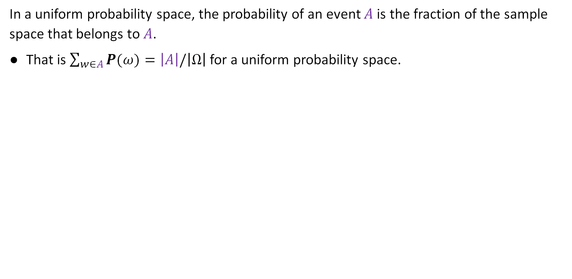



$A$ vs. $Ω$
In a uniform probability space, the probability of an event $A$is the fraction of the sample space that belongs to $A$.
That is $\sum_{w∈A}{P(ω)}=\left|A\right|/\left|Ω\right|$ for a uniform probability space.
$$P\left(A\right)=\frac{\left|A\right|}{\left|Ω\right|}$$
$$Ω$$
$$A$$

Slide 40


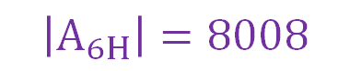

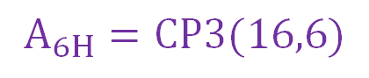
Probability Calculations
Common technique for solving probability problems.
Simply compute the relative size of two sets.
Very often, our set sizes in CS70 will be given by one of our four counting problems.
$$P\left(A_{6H}\right)=\frac{\left|A_{6H}\right|}{\left|Ω\right|}$$
All flips having 6 heads out of 16
$$Ω=CP2(2, 16)$$
$$\left|Ω\right|=2^{16}$$
$$A_{6H}=CP3(16,6)$$
$$\left|A_{6H}\right|=8008$$
All possible flips of 16 coins

Slide 41
Counting Weighted Sample Points
Introduction
Probability and CS70
Probability Spaces
Event Probability
Event Probability Examples
Counting Sample Points
Counting Weighted Sample Points
Poker Hands
Balls and Bins
The Birthday Paradox
Summary of Examples
The Monty Hall Problem
Simple Analysis
Sample Space Analysis
Lecture 15, CS70 Fall 2025

Slide 42
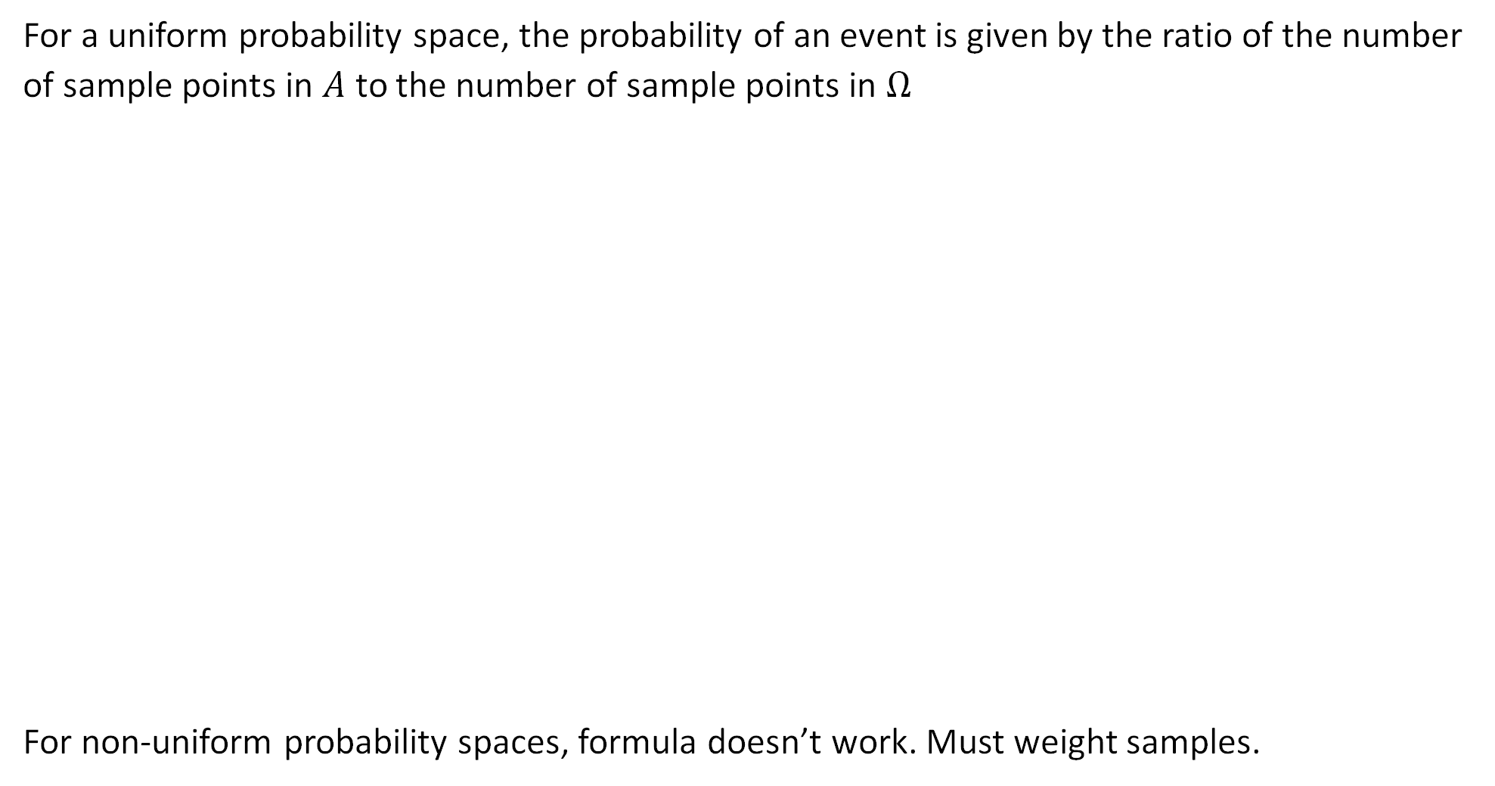


$A$ vs. $Ω$
For a uniform probability space, the probability of an event is given by the ratio of the number of sample points in $A$ to the number of sample points in $Ω$
For non-uniform probability spaces, formula doesn’t work. Must weight samples.
$$P\left(A\right)=\frac{\left|A\right|}{\left|Ω\right|}$$
$$Ω$$
$$A$$

Slide 43
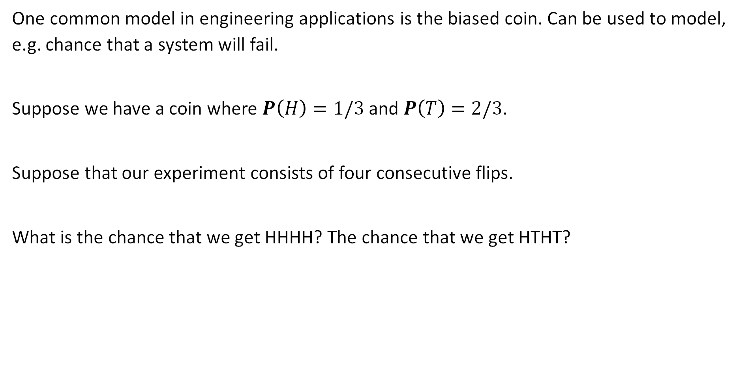
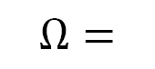
Four Biased Coins
One common model in engineering applications is the biased coin. Can be used to model, e.g. chance that a system will fail.
Suppose we have a coin where $P\left(H\right)=1/3$ and $P\left(T\right)=2/3$.
Suppose that our experiment consists of four consecutive flips.
What is the chance that we get HHHH? The chance that we get HTHT?
HHHH HHHT HHTH HHTT
HTHH HTHT HTTH HTTT
THHH THHT THTH THTT
TTHH TTHT TTTH TTTT
$$Ω=$$

Slide 44
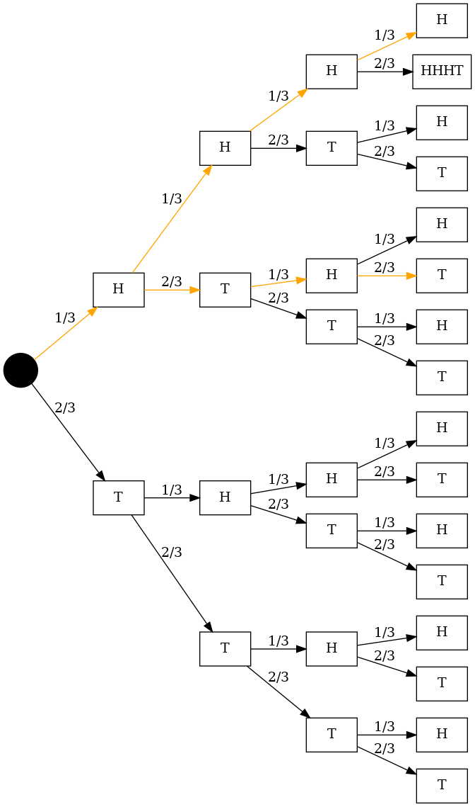
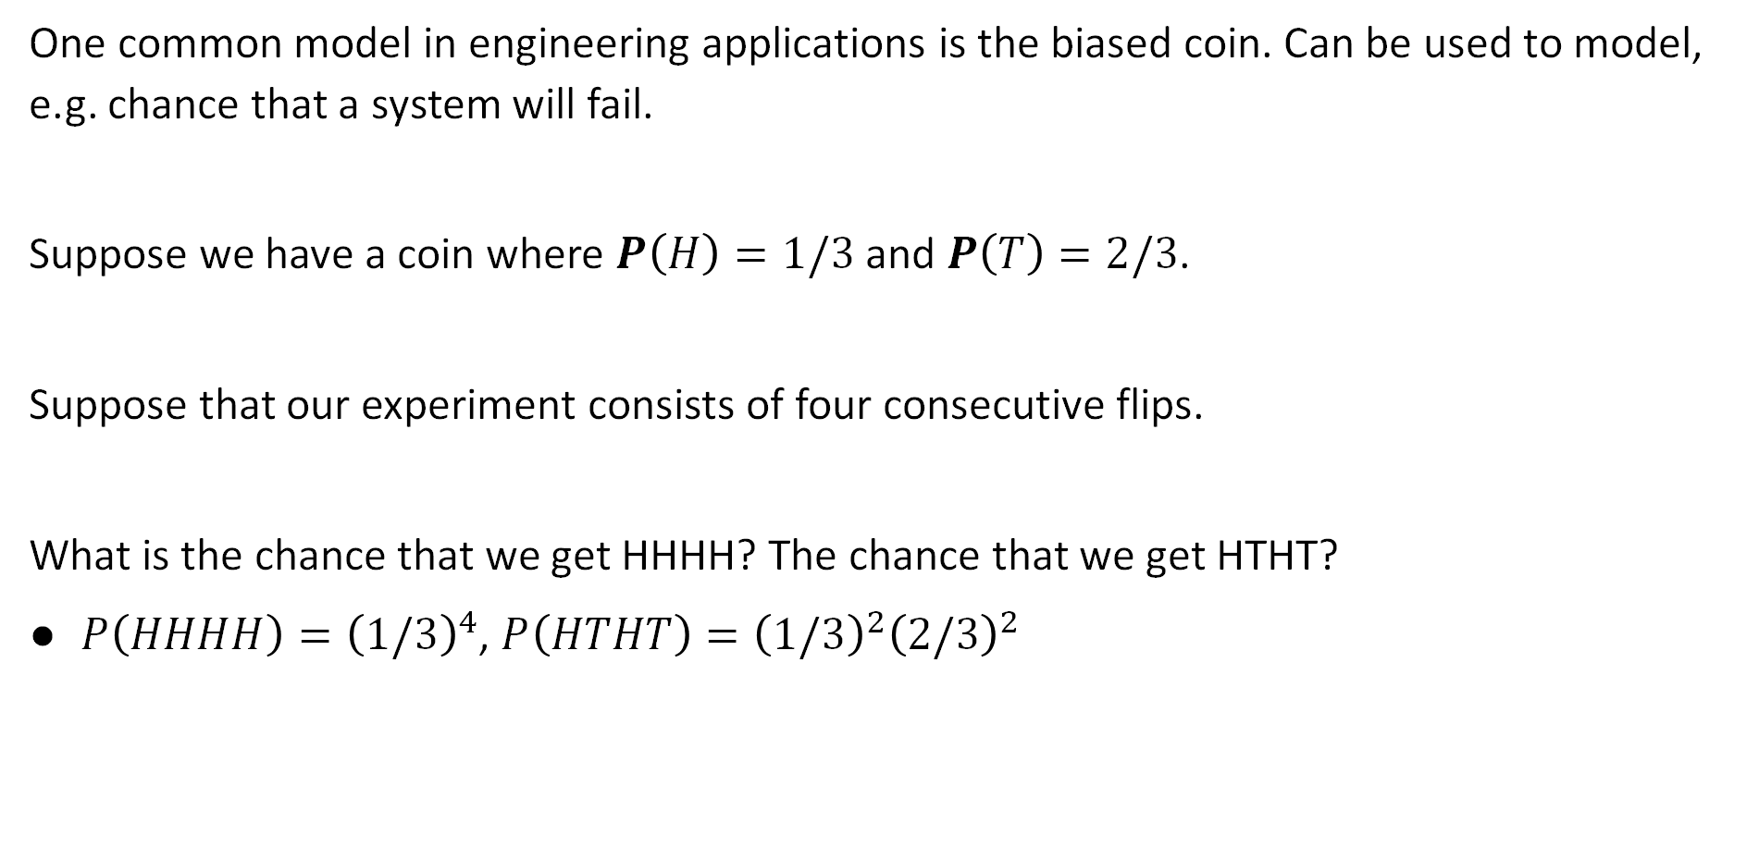
Four Biased Coins
One common model in engineering applications is the biased coin. Can be used to model, e.g. chance that a system will fail.
Suppose we have a coin where $P\left(H\right)=1/3$ and $P\left(T\right)=2/3$.
Suppose that our experiment consists of four consecutive flips.
What is the chance that we get HHHH? The chance that we get HTHT?
$P\left(HHHH\right)={\left(1/3\right)}^{4}$, $P\left(HTHT\right)={\left(1/3\right)}^{2}{\left(2/3\right)}^{2}$
HHHH HHHT HHTH HHTT
HTHH HTHT HTTH HTTT
THHH THHT THTH THTT
TTHH TTHT TTTH TTTT
$$Ω=$$
Non-uniform!
Notes:
Give me a .dot file showing all possible outcomes of flipping four biased coins with probability of heads 1/3 and tails 2/3. The graph should go from left to right with a node for the start, then 2 nodes connected to the start corresponding to heads and tails. Edges should be labeled with their probability. Nodes should be rectangles labeled either H or T. Highlight the edges in orange that go HHHH and highlight the edges in orange that go HTHT. All other edges should be black. All nodes should be black text on white background except the start node which should be a solid black circle.
Give me a .dot file showing all possible outcomes of flipping four biased coins with probability of heads 1/3 and tails 2/3. The graph should go from left to right with a node for the start, then 2 nodes connected to the start corresponding to heads and tails. Edges should be labeled with their probability. Nodes should be rectangles labeled either H or T. Highlight the edges in orange that go HHHH and highlight the edges in orange that go HTHT. All other edges should be black. All nodes should be black text on white background except the start node which should be a solid black circle.

Slide 45

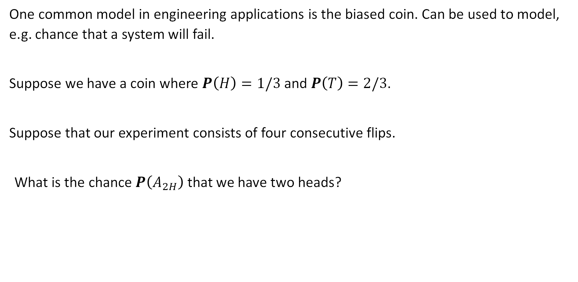
Four Biased Coins
One common model in engineering applications is the biased coin. Can be used to model, e.g. chance that a system will fail.
Suppose we have a coin where $P\left(H\right)=1/3$ and $P\left(T\right)=2/3$.
Suppose that our experiment consists of four consecutive flips.
What is the chance $P\left(A_{2H}\right)$ that we have two heads?
https://joshh.ug/D
HHHH HHHT HHTH HHTT
HTHH HTHT HTTH HTTT
THHH THHT THTH THTT
TTHH TTHT TTTH TTTT
$$Ω=$$

Slide 46


Four Biased Coins
Suppose we have a coin where $P\left(H\right)=1/3$ and $P\left(T\right)=2/3$.
Suppose that our experiment consists of four consecutive flips.
What is the chance $P\left(A_{2H}\right)$ that we have two heads?
First, compute probability of any specific two heads outcome, e.g. $P\left(HHTT\right)$
$P\left(HHTT\right)=P\left(HTHT\right)=…=P\left(HHTT\right)={\left(2/3\right)}^{2}{\left(1/3\right)}^{2}=4/81$
Then add the six probabilities: $P\left(HHTT\right)+P\left(HTHT\right)+…+P\left(HHTT\right)$
$P\left(A_{2H}\right)=6×4/81=24/81$
HHHH HHHT HHTH HHTT
HTHH HTHT HTTH HTTT
THHH THHT THTH THTT
TTHH TTHT TTTH TTTT
$$Ω=$$
Note: $\left(\begin{matrix}4 \\ 2\end{matrix}\right)=6$

Slide 47

Sixteen Biased Coins
Suppose we have a coin where $P\left(H\right)=1/3$ and $P\left(T\right)=2/3$.
Suppose that our experiment consists of 16 consecutive flips.
What is the chance $P(A_{6H})$ that we have exactly 6 heads?

Slide 48

Sixteen Biased Coins
Suppose we have a coin where $P\left(H\right)=1/3$ and $P\left(T\right)=2/3$.
Suppose that our experiment consists of 16 consecutive flips.
What is the chance $P(A_{6H})$ that we have exactly 6 heads?
Chance of any single specific outcome with 6 heads: ${\left(1/3\right)}^{6}{\left(2/3\right)}^{10}$
$P\left(HHHHHHTTTTTTTTTT\right)={\left(1/3\right)}^{6}{\left(2/3\right)}^{10}$
$P\left(THHHHHHTTTTTTTTT\right)={\left(1/3\right)}^{6}{\left(2/3\right)}^{10}$

Slide 49


Sixteen Biased Coins
Suppose we have a coin where $P\left(H\right)=1/3$ and $P\left(T\right)=2/3$.
Suppose that our experiment consists of 16 consecutive flips.
What is the chance $P(A_{6H})$ that we have exactly 6 heads?
Chance of any single specific outcome with 6 heads: ${z=\left(1/3\right)}^{6}{\left(2/3\right)}^{10}$
$P\left(HHHHHHTTTTTTTTTT\right)={\left(1/3\right)}^{6}{\left(2/3\right)}^{10}=z$
$P\left(THHHHHHTTTTTTTTT\right)={\left(1/3\right)}^{6}{\left(2/3\right)}^{10}=z$
…
So $P(A_{6H})$ is?
https://joshh.ug/E

Slide 50

Sixteen Biased Coins
Suppose we have a coin where $P\left(H\right)=1/3$ and $P\left(T\right)=2/3$.
Suppose that our experiment consists of 16 consecutive flips.
What is the chance $P(A_{6H})$ that we have exactly 6 heads?
Chance of any single specific outcome with 6 heads: ${z=\left(1/3\right)}^{6}{\left(2/3\right)}^{10}$
$P\left(HHHHHHTTTTTTTTTT\right)={\left(1/3\right)}^{6}{\left(2/3\right)}^{10}=z$
$P\left(THHHHHHTTTTTTTTT\right)={\left(1/3\right)}^{6}{\left(2/3\right)}^{10}=z$
…
So $P(A_{6H})$ is? $P\left(HHHHHHTTTTTTTTTT\right)+P\left(THHHHHHTTTTTTTTT\right)+…$
Add these together, but how many?

Slide 51


Sixteen Biased Coins
Suppose we have a coin where $P\left(H\right)=1/3$ and $P\left(T\right)=2/3$.
Suppose that our experiment consists of 16 consecutive flips.
What is the chance $P(A_{6H})$ that we have exactly 6 heads?
Chance of any single specific outcome with 6 heads: ${z=\left(1/3\right)}^{6}{\left(2/3\right)}^{10}$
$P\left(HHHHHHTTTTTTTTTT\right)={\left(1/3\right)}^{6}{\left(2/3\right)}^{10}=z$
$P\left(THHHHHHTTTTTTTTT\right)={\left(1/3\right)}^{6}{\left(2/3\right)}^{10}=z$
…
So $P(A_{6H})$ is? $\left(\begin{matrix}16 \\ 6\end{matrix}\right){{\left(1/3\right)}^{6}\left(2/3\right)}^{10}=\sim 19\%$
There are $\left(\begin{matrix}16 \\ 6\end{matrix}\right)$ of these. Sums to $P\left(A_{6H}\right)=$ $\left(\begin{matrix}16 \\ 6\end{matrix}\right)z$

Slide 52


$A_{6H}$ Visually
On a non-uniform probability space, probability is not based solely on relative set sizes.
$$P\left(A_{6H}\right)≠\frac{\left|A_{6H}\right|}{\left|Ω\right|}=\frac{8008}{2^{16}}$$
All flips having 6 heads out of 16
$$Ω=CP2(2, 16)$$
$$\left|Ω\right|=2^{16}$$
$$A_{6H}=CP3(16,6)$$
$$\left|A_{6H}\right|=8008$$
All possible flips of 16 coins

Slide 53


$A_{6H}$ Visually
On a non-uniform probability space, we must weight outcomes appropriately.
Instead of $P\left(A\right)=\frac{\left|A\right|}{\left|Ω\right|}$, we must use the general formula $P\left(A\right)=\sum_{ω∈A}{P\left(ω\right)}$.
All outcomes in $A_{6H}$ have probability ${{\left(1/3\right)}^{6}\left(2/3\right)}^{10}$, so $P\left(A_{6H}\right)=\left|A_{6H}\right|{{\left(1/3\right)}^{6}\left(2/3\right)}^{10}$
All flips having 6 heads out of 16
$$Ω=CP2(2, 16)$$
$$\left|Ω\right|=2^{16}$$
$$A_{6H}=CP3(16,6)$$
$$\left|A_{6H}\right|=8008$$
All possible flips of 16 coins
$$P\left(A_{6H}\right)=\left|A_{6H}\right|{{\left(1/3\right)}^{6}\left(2/3\right)}^{10}$$

Slide 54

Sixteen Biased Coins: A More Complicated Event
Suppose we have a coin where $P\left(H\right)=1/3$ and $P\left(T\right)=2/3$.
Suppose that our experiment consists of 16 consecutive flips.
What is the chance $P(A_{<4H})$ that we have fewer than 4 heads.
Chance of any single specific outcome with 0 heads: ${z=\left(1/3\right)}^{0}{\left(2/3\right)}^{16}$
And there’s only one of these.
Chance of any single specific outcome with 1 head: ${z=\left(1/3\right)}^{1}{\left(2/3\right)}^{15}$
And there are 16 of these.
…

Slide 55


Sixteen Biased Coins: A More Complicated Event
Suppose we have a coin where $P\left(H\right)=1/3$ and $P\left(T\right)=2/3$.
Suppose that our experiment consists of 16 consecutive flips.
What is the chance $P(A_{<4H})$ that we have fewer than 4 heads.
i | Chance of any specific way to get i heads | Number of ways to get i heads
0 | $${\left(1/3\right)}^{0}{\left(2/3\right)}^{16}$$ | $$\left({16 \atop 0}\right)=1$$
1 | $${\left(1/3\right)}^{1}{\left(2/3\right)}^{15}$$ | $$\left({16 \atop 1}\right)=16$$
2 | $${\left(1/3\right)}^{2}{\left(2/3\right)}^{14}$$ | $$\left({16 \atop 2}\right)=120$$
3 | $${\left(1/3\right)}^{3}{\left(2/3\right)}^{13}$$ | $$\left({16 \atop 3}\right)=560$$

Slide 56

Sixteen Biased Coins: A More Complicated Event
Suppose we have a coin where $P\left(H\right)=1/3$ and $P\left(T\right)=2/3$.
Suppose that our experiment consists of 16 consecutive flips.
What is the chance $P(A_{<4H})$ that we have fewer than 4 heads.
$$P\left(A_{<4H}\right)={\left(1/3\right)}^{0}{\left(2/3\right)}^{16}+16×{\left(1/3\right)}^{1}{\left(2/3\right)}^{15}+120×{\left(1/3\right)}^{2}{\left(2/3\right)}^{14}+560×{\left(1/3\right)}^{3}{\left(2/3\right)}^{13}$$
i | Chance of any specific way to get i heads | Number of ways to get i heads
0 | $${\left(1/3\right)}^{0}{\left(2/3\right)}^{16}$$ | $$\left({16 \atop 0}\right)=1$$
1 | $${\left(1/3\right)}^{1}{\left(2/3\right)}^{15}$$ | $$\left({16 \atop 1}\right)=16$$
2 | $${\left(1/3\right)}^{2}{\left(2/3\right)}^{14}$$ | $$\left({16 \atop 2}\right)=120$$
3 | $${\left(1/3\right)}^{3}{\left(2/3\right)}^{13}$$ | $$\left({16 \atop 3}\right)=560$$

Slide 57







$A_{<4H}$ Visually
We have that $P\left(A_{<4H}\right)=P\left(A_{0H}\right)+P\left(A_{1H}\right)+P\left(A_{2H}\right)+P\left(A_{3H}\right)$.
$$P\left(A_{<4H}\right)=\left|A_{0H}\right|P\left(ω∈A_{0H}\right)+…+\left|A_{3H}\right|P\left(ω∈A_{3H}\right)$$
$$A_{0H}$$
$$A_{3H}$$
$$A_{1H}$$
$$A_{2H}$$
$$Ω=CP2(2, 16)$$
$$\left|Ω\right|=2^{16}$$
All possible flips of 16 coins
$${|A}_{2H}|=120$$
$$P\left(ω∈A_{2H}\right)={\left(1/3\right)}^{2}{\left(2/3\right)}^{14}$$

Slide 58

$A_{<4H}$ as a Union of Events
Can also think of $A_{<4H}$ as $A_{0H}∪A_{1H}∪A_{2H}∪A_{3H}$.
Here ${P(A}_{<4H})=P\left(A_{0H}∪A_{1H}∪A_{2H}∪A_{3H}\right)=P\left(A_{0H}\right)+P\left(A_{1H}\right)+P\left(A_{2H}\right)+P\left(A_{3H}\right)$
We will revisit the probability of unions of events in the next lecture more carefully.
$$A_{0H}$$
$$A_{3H}$$
$$A_{1H}$$
$$A_{2H}$$
$$Ω=CP2(2, 16)$$
$$\left|Ω\right|=2^{16}$$
All possible flips of 16 coins
$${|A}_{2H}|=120$$
$$P\left(ω∈A_{2H}\right)={\left(1/3\right)}^{2}{\left(2/3\right)}^{14}$$

Slide 59

Sixteen Biased Coins
Suppose we have a coin where $P\left(H\right)=1/3$ and $P\left(T\right)=2/3$.
Suppose that our experiment consists of 16 consecutive flips.
What is the chance $P(A_{≥6H})$ that we have at least 6 heads?
Pink slides are slides that I made but decided not to use during lecture. You might find them useful.

Slide 60

Sixteen Biased Coins
Suppose we have a coin where $P\left(H\right)=1/3$ and $P\left(T\right)=2/3$.
Suppose that our experiment consists of 16 consecutive flips.
What is the chance $P(A_{≥6H})$ that we have at least 6 heads?
$P\left(A_{≥6H}\right)=P\left(A_{6H}\right)+P\left(A_{7H}\right)+…+P\left(A_{16H}\right)$
Just showed that $P\left(A_{6H}\right)={P\left(A_{6H}\right)=\left(\begin{matrix}16 \\ 6\end{matrix}\right)\left(1/3\right)}^{6}{\left(2/3\right)}^{10}$
Can repeat for $P\left(A_{7H}\right)$, $P\left(A_{8H}\right)$, etc.

Slide 61



Sixteen Biased Coins
Suppose we have a coin where $P\left(H\right)=1/3$ and $P\left(T\right)=2/3$.
Suppose that our experiment consists of 16 consecutive flips.
What is the chance $P(A_{≥6H})$ that we have at least 6 heads?
$P\left(A_{≥6H}\right)=P\left(A_{6H}\right)+P\left(A_{7H}\right)+…+P\left(A_{16H}\right)$
Just showed that $P\left(A_{6H}\right)={P\left(A_{6H}\right)=\left(\begin{matrix}16 \\ 6\end{matrix}\right)\left(1/3\right)}^{6}{\left(2/3\right)}^{10}$
$$P\left(A_{iH}\right)=\left(\begin{matrix}16 \\ i\end{matrix}\right){\left(\frac{1}{3}\right)}^{i}{\left(\frac{2}{3}\right)}^{16−i}$$
$$P\left(A\right)=\sum_{i=6}^{16}{\left(\begin{matrix}16 \\ i\end{matrix}\right){\left(\frac{1}{3}\right)}^{i}{\left(\frac{2}{3}\right)}^{16−i}}$$

Slide 62
Poker Hands
Introduction
Probability and CS70
Probability Spaces
Event Probability
Event Probability Examples
Counting Sample Points
Counting Weighted Sample Points
Poker Hands
Balls and Bins
The Birthday Paradox
Summary of Examples
The Monty Hall Problem
Simple Analysis
Sample Space Analysis
Lecture 15, CS70 Fall 2025

Slide 63

Playing Cards
In a standard deck of American playing cards, there are 52 cards.
Each card has a “rank” and a “suit”.
Ranks: {A, 2, 3, 4, 5, 6, 7, 8, 9, 10, J, Q, K}
Suits: {♠, ♥,♦,♣}
When shuffled, there are 52! (roughly $8×{10}^{67}$) permutations.
No two shuffled decks have ever been the same!

Slide 64

Poker Hands as a Random Experiment
In the game of poker, each player is given a “hand” consisting of 5 cards from the set of 52 cards shown below.
Each card has a “rank” and a “suit”.
Ranks: {A, 2, 3, 4, 5, 6, 7, 8, 9, 10, J, Q, K}
Suits: {♠, ♥,♦,♣}
Example Hand: {A♥, 2♣, 5♣, K♣, Q♦}
Questions:
What is n (the cardinality of the set we’re drawing from)? What is k? What is $\left|Ω\right|$? Which CP?
Is this with/without replacement? Order?
Uniform probability space?

Slide 65

Poker Hands as a Random Experiment
In the game of poker, each player is given a “hand” consisting of 5 cards from the set of 52 cards shown below.
Each card has a “rank” and a “suit”.
Ranks: {A, 2, 3, 4, 5, 6, 7, 8, 9, 10, J, Q, K}
Suits: {♠, ♥,♦,♣}
Example Hand: {A♥, 2♣, 5♣, K♣, Q♦}
Will see later we can use CP1 instead!
Questions:
What is n (the cardinality of the set we’re drawing from)? What is k? What is $\left|Ω\right|$? Which CP?
Is this with/without replacement? Order?
Uniform probability space?
My answers: $Ω$is given by CP3.
n is 52. k is 5. Drawing without replacement. Ignoring order.
$\left|Ω\right|:$ Drawing 5 items without replacement from a set of cardinality 52: $\left({52 \atop 5}\right)$ or 2,598,960 possible hands.
The space is uniform.

Slide 66


Poker Hands as a Random Experiment
In the game of poker, each player is given a “hand” consisting of 5 cards from the set of 52 cards shown below.
Each card has a “rank” and a “suit”.
Ranks: {A, 2, 3, 4, 5, 6, 7, 8, 9, 10, J, Q, K}
Suits: {♠, ♥,♦,♣}
Example Hand: {A♥, 2♣, 5♣, K♣, Q♦}
Question: Which hand is more likely?

Slide 67
Poker Hands as a Random Experiment
In the game of poker, each player is given a “hand” consisting of 5 cards from the set of 52 cards shown below.
Each card has a “rank” and a “suit”.
Ranks: {A, 2, 3, 4, 5, 6, 7, 8, 9, 10, J, Q, K}
Suits: {♠, ♥,♦,♣}
Example Hand: {A♥, 2♣, 5♣, K♣, Q♦}
Question: Which hand is more likely?
They are equally likely. It’s a uniform probability space.

Slide 68

Poker Hands: Probability of a “Flush”
In the game of poker, each player is given a “hand” consisting of 5 cards from the set of 52 cards shown below.
Let $A$ be the event where hand is a “flush”, i.e. has all the same suit? $P\left(A\right)$?
This is a uniform probability space so we just need to compute $\left|A\right|/\left|Ω\right|$.
$\left|Ω\right|$: Given by CP3(52, 5). Number of possible hands (ignoring order): $\left({52 \atop 5}\right)$ or 2,598,960.
$\left|A_{\text{♥}}\right|:$ Number of different ♥ flushes (ignoring order):
Example Flushes: {A♥, 2♥, 5♥, K♥, Q♥}
{5♥, A♥, 2♥, Q♥, K♥}
https://joshh.ug/F

Slide 69

Poker Hands: Probability of a “Flush”
In the game of poker, each player is given a “hand” consisting of 5 cards from the set of 52 cards shown below.
Let $A$ be the event where hand is a “flush”, i.e. has all the same suit? $P\left(A\right)$?
This is a uniform probability space so we just need to compute $\left|A\right|/\left|Ω\right|$.
$\left|Ω\right|$: Given by CP3(52, 5). Number of possible hands (ignoring order): $\left({52 \atop 5}\right)$ or 2,598,960.
$\left|A_{\text{♥}}\right|:$ Number of different ♥ flushes ignoring order: Given by CP3(13, 5). Out of 13 hearts, how many ways to draw 5 hearts? Yields $\left(\begin{matrix}13 \\ 5\end{matrix}\right)=1287$ heart flushes.
Four different suits, so total number of flushes = 5,148
Thus, chance of a flush is 5,148/2,598,960 $≈$ 0.2%
Example Flushes: {A♥, 2♥, 5♥, K♥, Q♥}
{5♥, A♥, 2♥, Q♥, K♥}

Slide 70

Poker Hands as a Random Experiment (CP1 Framing, i.e. Considering Order)
In the game of poker, each player is given a “hand” consisting of 5 cards from the set of 52 cards shown below.
Each card has a “rank” and a “suit”.
Ranks: {A, 2, 3, 4, 5, 6, 7, 8, 9, 10, J, Q, K}
Suits: {♠, ♥,♦,♣}
Example Hand: {A♥, 2♣, 5♣, K♣, Q♦}
Questions:
What is n (the cardinality of the set we’re drawing from)? What is k? What is $\left|Ω\right|$? Which CP?
Is this with/without replacement? Order?
Uniform probability space?
My answers: $Ω$is given by CP1.
n is 52. k is 5. Drawing without replacement. Considering order.
$\left|Ω\right|:$ Drawing 5 items without replacement from a set of cardinality 52: $52×51×50×49×48$ or 311,875,200 possible hands.
The space is uniform.

Slide 71

Poker Hands as a Random Experiment (CP1 Framing, i.e. Considering Order)
In the game of poker, each player is given a “hand” consisting of 5 cards from the set of 52 cards shown below.
Let $A$ be the event where hand is a “flush”, i.e. has all the same suit? $P\left(A\right)$?
This is a uniform probability space so we just need to compute $\left|A\right|/\left|Ω\right|$.
$\left|Ω\right|$: Given by CP1(52, 5). Number of possible hands (taking into account order): $52×51×50×49×48$ or 311,875,200.
$\left|A_{\text{♥}}\right|:$ Number of different ♥ flushes:
Example Flushes: {A♥, 2♥, 5♥, K♥, Q♥}
{5♥, A♥, 2♥, Q♥, K♥}

Slide 72

Poker Hands as a Random Experiment (CP1 Framing, i.e. Considering Order)
In the game of poker, each player is given a “hand” consisting of 5 cards from the set of 52 cards shown below.
Let $A$ be the event where hand is a “flush”, i.e. has all the same suit? $P\left(A\right)$?
This is a uniform probability space so we just need to compute $\left|A\right|/\left|Ω\right|$.
$\left|Ω\right|$: Given by CP1(52, 5). Number of possible hands (taking into account order): $52×51×50×49×48$ or 311,875,200.
$\left|A_{\text{♥}}\right|:$ Number of different ♥ flushes: Given by CP1(13, 5). Out of 13 hearts, how many ways to draw 5 hearts? Yields $13×12×11×10×9$ or 154,440 heart flushes.
Four different suits, so total number of flushes = 617,760
Thus, chance of a flush is 617,760/311,875,200 $≈$ 0.2%
Example Flushes: {A♥, 2♥, 5♥, K♥, Q♥}
{5♥, A♥, 2♥, Q♥, K♥}

Slide 73

Observation: CP1 and CP3 Both worked
Earlier, when drawing with replacement (e.g. rolling dice), it was important to consider order to ensure a uniform probability space.
By contrast, when drawing without replacement (e.g. drawing cards), it doesn’t actually matter if you consider order.
Why?
When drawing with replacement (e.g. dice rolls), ignoring order means samples with repeat draws are less likely if the individual draws are fair, e.g. $P\left(\left\{1, 1\right\}\right)≤P(\left\{2, 1\right\})$.
When drawing without replacement, this is not a concern. Can’t get repeat draws in a single sample.

Slide 74

CP1 vs. CP3 Doesn’t Matter
When drawing without replacement, it doesn’t really matter if we choose to frame as CP1 or CP3.
Both framings yield uniform probability spaces, so calculations are equally easy.
Recall that $\left|CP3\right|=\frac{\left|CP1\right|}{k!}$.
Example: Computing the probability of a flush: $P\left(A\right)=\frac{\left|A\right|}{\left|Ω\right|}$
Framing as CP1 basically adds an extra factor of $k!$ to both the numerator and denominator.
By contrast, when rolling dice (i.e. with replacement), we want to frame as CP2 and not CP4 to ensure a uniform probability space.
There is no nice k-to-1 function.

Slide 75
Balls and Bins
Introduction
Probability and CS70
Probability Spaces
Event Probability
Event Probability Examples
Counting Sample Points
Counting Weighted Sample Points
Poker Hands
Balls and Bins
The Birthday Paradox
Summary of Examples
The Monty Hall Problem
Simple Analysis
Sample Space Analysis
Lecture 15, CS70 Fall 2025

Slide 76
Example: Balls and Bins
Suppose we throw 20 balls independently into 10 bins. Assume each ball is equally likely to land in any of the ten bins.
Let’s do a quick demo.

Slide 77

Example: Balls and Bins
Suppose we throw 20 balls independently into 10 bins. Assume each ball is equally likely to land in any of the ten bins.
Suppose we want to be able to answer questions like: “What is $P(A_{bin1empty})$?”
How should we define the sample space?
How can we ensure our probability space is uniform?
(If watching the video, you might consider pausing here to think about this)

Slide 78
Example: Balls and Bins
Suppose we throw 20 balls independently into 10 bins. Assume each ball is equally likely to land in any of the ten bins.
My proposal: Treat just like 20 ordered dice throws (CP2).
Example outcome: [5, 6, 2, 6, 8, 3, 9, 4, 9, 2, 1, 8, 2, 1, 9, 2, 2, 4, 4, 5]

Slide 79

Example: Balls and Bins
Suppose we throw 20 balls independently into 10 bins. Assume each ball is equally likely to land in any of the ten bins.
Framed as CP2 (ordered, w/replacement) with k=20, n=10, $\left|Ω\right|={10}^{20}$
Note: By using CP2 as our framing, we’ve effectively labeled the balls.
This is true even though the original problem had no labels.
Ensures probability space is uniform.
H
D
G
I
B
E
3
A
6
8
J
1
K
2
4
C
5
F
9
7

Slide 80

Example: Balls and Bins
Suppose we throw 20 balls independently into 10 bins. Assume each ball is equally likely to land in any of the ten bins.
k=20, n=10, with replacement, $\left|Ω\right|={10}^{20}$
What is $P(A_{bin1empty})$, i.e. the probability bin 1 has no ball?
Since all outcomes are equally likely, just need to count number of outcomes where no ball lands in bin 1.
Number of ways 20 balls can land in 9 bins:

Slide 81

Example: Balls and Bins
Suppose we throw 20 balls independently into 10 bins. Assume each ball is equally likely to land in any of the ten bins.
k=20, n=10, with replacement, $\left|Ω\right|={10}^{20}$
What is $P(A_{bin1empty})$, i.e. the probability bin 1 has no ball?
Since all outcomes are equally likely, just need to count number of outcomes where no ball lands in bin 1.
Number of ways 20 balls can land in 9 bins:
https://joshh.ug/G

Slide 82

Example: Balls and Bins
Suppose we throw 20 balls independently into 10 bins. Assume each ball is equally likely to land in any of the ten bins.
k=20, n=10, with replacement, $\left|Ω\right|={10}^{20}$
What is $P(A_{bin1empty})$, i.e. the probability bin 1 has no ball?
Since all outcomes are equally likely, just need to count number of outcomes where no ball lands in bin 1.
Number of ways 20 balls can land in 9 bins: $9^{20}$
Can think of this as “Assume that the first bin is empty, how many different configurations are there?”
So $P\left(A_{bin1empty}\right)=9^{20}/{10}^{20}≈12\%$

Slide 83

Example: Balls and Bins
Suppose we throw 20 balls independently into 10 bins. Assume each ball is equally likely to land in any of the ten bins.
k=20, n=10, with replacement, $\left|Ω\right|={10}^{20}$
What is $P(A_{bin1empty})$, i.e. the probability bin 1 has no ball?
$9^{20}/{10}^{20}$ $≈12\%$
What is $P(A_{bin1nonempty})$, i.e. the probability at least one ball lands in bin 1?
This is just $1−P\left(A_{bin1empty}\right)=1−9^{20}/{10}^{20}≈88\%$
In general, for an event $A$, $P\left(A\right)=1−P\left(\overline{A}\right)$

Slide 84




Example: Balls and Bins
Suppose we throw $m$ balls independently into $n$ bins. Assume each ball is equally likely to land in any of the $n$ bins.
k=$m$, n=$n$, with replacement, $\left|Ω\right|=n^{m}$
What is $P(A_{bin1empty})$, i.e. the probability bin 1 has no ball?
For k = 20, n = 10, we had $P\left(A_{bin1empty}\right)=9^{20}/{10}^{20}$
For k = $m$, n = $n$, we have $P\left(A_{bin1empty}\right)={(n−1)}^{m}/n^{m}$
So $P\left(A_{bin1empty}\right)=\frac{{\left(n−1\right)}^{m}}{n^{m}}$
$$={\left(\frac{n−1}{n}\right)}^{m}$$
$$={\left(1−\frac{1}{n}\right)}^{m}$$
Number of ways m balls can land in n-1 bins: ${(n−1)}^{m}$

Slide 85



Example: Balls and Bins
So $P\left(A_{bin1empty}\right)=\frac{{\left(n−1\right)}^{m}}{n^{m}}$
Another way to arrive at this equation is to consider that the chance of landing in some bin other than bin 1 is $\left(1−\frac{1}{n}\right)$.
Chance of throwing two balls and neither landing in bin 1 is ${\left(1−\frac{1}{n}\right)}^{2}$.
Chance of throwing k balls and none landing in bin 1 is ${\left(1−\frac{1}{n}\right)}^{k}$.
$$={\left(\frac{n−1}{n}\right)}^{m}$$
$$={\left(1−\frac{1}{n}\right)}^{m}$$

Slide 86

Buckets and Balls and the World
Suppose we throw $m$ balls independently into $n$ bins. Assume each ball is equally likely to land in any of the $n$ bins.
This problem is a common model in computer science, e.g. modeling jobs being sent to one of many servers. Suppose $m$ jobs are sent to one of $n$ servers randomly.
$P\left(A_{server1notused}\right)={\left(\frac{n−1}{n}\right)}^{m}={\left(1−\frac{1}{n}\right)}^{m}$
Or $m$ items are stored in one of $n$ hash table buckets:
$P\left(A_{bucket1notused}\right)={\left(\frac{n−1}{n}\right)}^{m}={\left(1−\frac{1}{n}\right)}^{m}$

Slide 87
The Birthday Paradox
Introduction
Probability and CS70
Probability Spaces
Event Probability
Event Probability Examples
Counting Sample Points
Counting Weighted Sample Points
Poker Hands
Balls and Bins
The Birthday Paradox
Summary of Examples
The Monty Hall Problem
Simple Analysis
Sample Space Analysis
Lecture 15, CS70 Fall 2025

Slide 88
Birthdays
Suppose we have 50 people in a room. What is the chance that two share a birthday? (For simplicity, ignore leap year birthdays, i.e. assume each year has 365 days).
What’s your gut feeling?
Less than 20%?
Decent chance, say 50%ish?
Very likely, say >90%?

Slide 89

Birthdays
Suppose we have 50 people in a room who all have a birthday between day 1 and day 365.
What is the probability space for the possible birthdays?
What is the cardinality of the set S that we’re drawing from?
How many samples are we drawing?
Are we drawing with or without replacement?
Are we considering order?
What is the cardinality of the sample space $Ω$?

Slide 90

Birthdays
Suppose we have 50 people in a room who all have a birthday between day 1 and day 365.
What is the probability space for the possible birthdays? This is CP2.
What is the cardinality of the set S that we’re drawing from? 365
How many samples are we drawing? 50
Are we drawing with or without replacement? With
Are we considering order? Yes (uniform probability space)
What is the cardinality of the sample space $Ω$?$\left|Ω\right|={365}^{50}$
Note: This is just CP2 again. Same as balls-and-bins with 50 balls and 365 bins. Or rolling a 365- sided die 50 times.

Slide 91

Birthdays
Suppose we have 50 people in a room who all have a birthday between day 1 and day 365.
Cardinality of the sample space $Ω$? $\left|Ω\right|={365}^{50}$
Let $A$ be the event where two (or more) of the birthdays are the same. Then:
$$P\left(A\right)=\frac{\left|A\right|}{\left|Ω\right|}$$
Examples from $A$: [1, 1, …], [5, 5, …5, …], [66, 12, 51, 66, …]
Problem: How the heck do we figure out $\left|A\right|$?

Slide 92

Birthdays
Suppose we have 50 people in a room who all have a birthday between day 1 and day 365.
Cardinality of the sample space $Ω$? $\left|Ω\right|={365}^{50}$
Let $A$ be the event where two (or more) of the birthdays are the same. Hard to compute $\left|A\right|$.
As is sometimes the case, $\left|\overline{A}\right|$ is easier to compute.
Example from $\left|\overline{A}\right|$: [55, 1, 67, 2, 99, …, 33, 41], with no repeats.
How many samples are there like this with no repeats?
Let’s think about this as a different counting problem.

Slide 93
Birthdays with no Repeats
Suppose we have 50 people in a room who all have a birthday between day 1 and day 365 AND THERE ARE NO REPEAT BIRTHDAYS.
Goal: Figure out the size of this sample space.
What is the cardinality of the set S that we’re drawing from?
How many samples are we drawing?
Are we drawing with or without replacement?
What is the cardinality of this sample space?

Slide 94

Birthdays with no Repeats
Suppose we have 50 people in a room who all have a birthday between day 1 and day 365 AND THERE ARE NO REPEAT BIRTHDAYS.
Goal: Figure out the size of this sample space.
What is the cardinality of the set S that we’re drawing from? 365
How many samples are we drawing? 50
Are we drawing with or without replacement? Without
What is the cardinality of this sample space?
https://joshh.ug/H

Slide 95

Birthdays with no Repeats
Suppose we have 50 people in a room who all have a birthday between day 1 and day 365 AND THERE ARE NO REPEAT BIRTHDAYS.
Goal: Figure out the size of this sample space.
What is the cardinality of the set S that we’re drawing from? 365
How many samples are we drawing? 50
Are we drawing with or without replacement? Without
What is the cardinality of this sample space? $365×364×…×316$
Note that this sample space is just $\overline{A}$, i.e. $\left|\overline{A}\right|=365×364×…×316$

Slide 96


Birthdays
Suppose we have 50 people in a room who all have a birthday between day 1 and day 365. What is the chance that two of those 50 people share the same birthday?
Let $A$ be the event where two (or more) of the birthdays are the same. Then:
$$P\left(A\right)=\frac{\left|A\right|}{\left|Ω\right|}=1−P\left(\overline{A}\right)=1−\frac{\left|\overline{A}\right|}{\left|Ω\right|}$$
For $k=50$, $\left|\overline{A}\right|=365×364×…×316$, and $\left|Ω\right|={365}^{50}$, so
$$P\left(A\right)=1−\frac{365×364×…×316}{{365}^{50}}$$
Can use e.g. Wolfram|Alpha to compute.

Slide 97

Birthdays
Suppose we have 50 people in a room who all have a birthday between day 1 and day 365. What is the chance that two of those 50 people share the same birthday?
Let $A$ be the event where two (or more) of the birthdays are the same. Then:
$$P\left(A\right)=\frac{\left|A\right|}{\left|Ω\right|}=1−P\left(\overline{A}\right)=1−\frac{\left|\overline{A}\right|}{\left|Ω\right|}$$
For $k=50$, $\left|\overline{A}\right|=365×364×…×316$, and $\left|Ω\right|={365}^{50}$, so
$$P\left(A\right)=1−\frac{365×364×…×316}{{365}^{50}}≈1−0.03≈0.97$$

Slide 98

Birthdays
Suppose we have 50 people in a room who all have a birthday between day 1 and day 365. What is the chance that two of those 50 people share the same birthday?
Compute by counting number of birthday combinations with no repeats.
$$\left|\overline{A}\right|=365×364×…×316$$
Suppose we want to generalize to the case where we have $n$ people. What is $\left|\overline{A}\right|$ in that case?
$$P\left(A\right)=1−\frac{365×364×…×316}{{365}^{50}}≈1−0.03≈0.97$$

Slide 99
Birthdays
Suppose we have 50 people in a room who all have a birthday between day 1 and day 365. What is the chance that two of those 50 people share the same birthday?
Compute by counting number of birthday combinations with no repeats.
$$\left|\overline{A}\right|=365×364×…×316$$
Suppose we want to generalize to the case where we have $n$ people. What is $\left|\overline{A}\right|$ in that case?
$$\left|\overline{A}\right|=365×364×…×\left(365−n+1\right)$$

Slide 100

Birthdays
Suppose we have $m$ people in a room who all have a birthday between day 1 and day 365. What is the chance that two of those $m$ people share the same birthday?
$$P\left(A\right)=1−\frac{365×364×…×\left(365−m+1\right)}{{365}^{m}}$$

Slide 101
Quick Aside: Computing This Function
Suppose we want to compute the results of the function below.
Why might it be a bad idea to compute the numerator and denominator separately?
How can we compute the result more efficiently?
$$P\left(A\right)=1−\frac{365×364×…×\left(365−m+1\right)}{{365}^{m}}$$

Slide 102

Quick Aside: Computing This Function
Suppose we want to compute the results of the function below.
Why might it be a bad idea to compute the numerator and denominator separately?
In many programming languages like Java, we’d get overflow issues.
In languages that support huge integers, performance will be slow. ${365}^{100}$ is an 852 bit number, much bigger than 64 bits for typical operations.
How can we compute the result more efficiently?
One idea: Compute product of $\frac{365}{365}×\frac{364}{365}×\frac{363}{365}×…$
You can compute this approximately in constant time (maybe try to come up with a technique, happy to discuss at office hours!)
$$P\left(A\right)=1−\frac{365×364×…×\left(365−m+1\right)}{{365}^{m}}$$

Slide 103



Birthday Paradox Table
For various $m$, the probability that at least two people share a birthday is given below.
$$m$$ | $$P(A)$$ | $$\%$$
1 | 0 | 0%
2 | 0.0027 | 0.27%
3 | 0.008 | 0.8%
4 | 0.016 | 1.6%
10 | 0.117 | 11.7%
15 | 0.252 | 25.2%
20 | 0.411 | 41.1%
23 | 0.507 | 50.7%
50 | 0.97 | 97.0%
60 | 0.994 | 99.4%
m
23 is where we cross 50%

Slide 104
Summary of Examples
Introduction
Probability and CS70
Probability Spaces
Event Probability
Event Probability Examples
Counting Sample Points
Counting Weighted Sample Points
Poker Hands
Balls and Bins
The Birthday Paradox
Summary of Examples
The Monty Hall Problem
Simple Analysis
Sample Space Analysis
Lecture 15, CS70 Fall 2025

Slide 105

Coins, Dice, Balls & Bins, and Birthdays
Flipping coins, rolling dice, tossing balls into bins, and picking birthdays are all the same problem: $CP2(n, k)$, where $n$ is the cardinality of the set we’re drawing from, and $k$ is the number of samples drawn.
Rolling a 4 sided die twice: $k=2$, $n=4$.
Flipping a coin 16 times: $k= ?$, $n= ?$.

Slide 106

Coins, Dice, Balls & Bins, and Birthdays
Flipping coins, rolling dice, tossing balls into bins, and picking birthdays are all the same problem: $CP2(n, k)$, where $n$ is the cardinality of the set we’re drawing from, and $k$ is the number of samples drawn.
Rolling a 4 sided die twice: $k=2$, $n=4$.
Flipping a coin 16 times: $k=16$, $n=2$.
Tossing 20 balls in 10 bins: $k= ?$, $n= ?$.

Slide 107

Coins, Dice, Balls & Bins, and Birthdays
Flipping coins, rolling dice, tossing balls into bins, and picking birthdays are all the same problem: $CP2(n, k)$, where $n$ is the cardinality of the set we’re drawing from, and $k$ is the number of samples drawn.
Rolling a 4 sided die twice: $k=2$, $n=4$.
Flipping a coin 16 times: $k=16$, $n=2$.
Tossing 20 balls in 10 bins: $k=10$, $n=20$.
Picking 23 birthdays: $k= ?$, $n= ?$.

Slide 108

Coins, Dice, Balls & Bins, and Birthdays
Flipping coins, rolling dice, tossing balls into bins, and picking birthdays are all the same problem: $CP2(n, k)$, where $n$ is the cardinality of the set we’re drawing from, and $k$ is the number of samples drawn.
Rolling a 4 sided die twice: $k=2$, $n=4$.
Flipping a coin 16 times: $k=16$, $n=2$.
Tossing 20 balls in 10 bins: $k=10$, $n=20$.
Picking 23 birthdays: $k=23$, $n=365$.
Example: Chance of getting the same die roll in 23 rolls of a 365-sided die is around 50%.

Slide 109

Coins, Dice, Balls & Bins, and Birthdays
Flipping coins, rolling dice, tossing balls into bins, and picking birthdays are all the same problem: $CP2(n, k)$, where $n$ is the cardinality of the set we’re drawing from, and $k$ is the number of samples drawn.
Rolling a 4 sided die twice: $k=2$, $n=4$.
Flipping a coin 16 times: $k=16$, $n=2$.
Tossing 20 balls in 10 bins: $k=10$, $n=20$.
Picking 23 birthdays: $k=23$, $n=365$.
Drawing cards, picking the position for heads, or picking birthdays without repeats are all the same problem: $CP3\left(n, k\right)$ [though you can also use $CP1$]:
Drawing 5 cards from a deck of 52: $k=5, n=4$.
Figuring out how many ways to 6 heads out of 16 flips: $k=6, n=16$.
Picking 23 birthdays without repeats: $k=23, n=365$.

Slide 110

Summary of Lecture So Far
Probability is hard!
Intuitions can be wildly wrong. We’ll see one more example today.
Rigor is critical for correctness.
Recall the key steps in all our calculations (framed slightly differently):
Determine $Ω$, the set of all possible outcomes. Favor $CP2$ over $CP4$.
Determine $P(ω)$, the probability of each outcome $ω∈Ω$?
For uniform probability spaces, $P\left(ω\right)=1/\left|Ω\right|$
Determine the event $A$ that we’re interested in.
Compute the probability of $A$ by adding up the probabilities of the sample points contained in it. For uniform spaces, $P\left(A\right)=\left|A\right|/|Ω|$
Often involves counting the size of $A$.
Sometimes the complement of an event is easier to count.

Slide 111
The Monty Hall Problem: Simple Analysis
Introduction
Probability and CS70
Probability Spaces
Event Probability
Event Probability Examples
Counting Sample Points
Counting Weighted Sample Points
Poker Hands
Balls and Bins
The Birthday Paradox
Summary of Examples
The Monty Hall Problem
Simple Analysis
Sample Space Analysis
Lecture 15, CS70 Fall 2025

Slide 112
Probability Spaces and Event Probabilities
Let’s consider a much trickier problem using the same framework as before.

Slide 113

The Monty Hall Problem
Let’s start by imagining a game. In this game there are 3 doors with prizes behind them, and you want to win the car.
One door has a car behind it.
Two doors have a goat behind them.

Slide 114
The Monty Hall Problem
Let’s start by imagining a game. In this game there are 3 doors with prizes behind them, and you want to win the car.
One door has a car behind it.
Two doors have a goat behind them.
The rules are as follows:
You pick one of 3 doors.
The host reveals what is behind one of the other doors. The answer is ALWAYS a goat.
You ALWAYS get a chance to switch doors after the host shows you the goat.
Let’s try to play a few rounds: https://www.rossmanchance.com/applets/2021/montyhall/Monty.html

Slide 115

The Monty Hall Problem
Suppose we’re playing, pick the left door, and we get to this state:
Should you switch doors? (Note: You are ALWAYS shown a goat)

Slide 116
Monty Hall Problem
Strangely the answer is yes - your chance of winning is better if you switch!

Slide 117

Explanation (1/4)
The chance that you were correct with your first guess is 1/3.
Only two possibilities exist:
You were right (with probability 1/3).
You were wrong (with probability 2/3).

Slide 118

Explanation (2/4)
Suppose the host opens door 3, how do the probabilities change?
Chance that your original choice is correct is unchanged. It’s still 1/3.

Slide 119
Explanation (3/4)
Suppose the host opens door 3, how do the probabilities change?
Chance that your original choice is correct is unchanged. It’s still 1/3.
Chance that door 3 has the car is now zero.

Slide 120
Explanation (4/4)
Suppose the host opens door 3, how do the probabilities change?
Chance that your original choice is correct is unchanged. It’s still 1/3.
Chance that door 3 has the car is now zero.
Chance that door 2 has the car is now 2/3 (since door 3 can’t have car).

Slide 121
Explanation Summary
The chance that you were correct with your first guess is 1/3.
That is, only two possibilities exist before the door is open:
You are right (with probability 1/3).
You are wrong (with probability 2/3).
After opening a door, the chance you were right is STILL 1/3.
So switching (to the other binary choice) must have a probability of 2/3.

Slide 122
Monty Hall Problem
When this problem was answered in Parade magazine by columnist Marilyn vos Savant in 1990, the answer drew huge amounts of angry mail including from folks holding PhDs.
Let’s take a walk down memory lane: https://web.archive.org/web/20130121183432/http://marilynvossavant.com/game-show-problem/

Slide 123
The Monty Hall Problem: Sample Space Analysis
Introduction
Probability and CS70
Probability Spaces
Event Probability
Event Probability Examples
Counting Sample Points
Counting Weighted Sample Points
Poker Hands
Balls and Bins
The Birthday Paradox
Summary of Examples
The Monty Hall Problem
Simple Analysis
Sample Space Analysis
Lecture 15, CS70 Fall 2025

Slide 124

Explanation in Terms of Sample Spaces
We can also think about this problem in terms of a sample space where we draw 3 samples from the set S = {1, 2, 3}:
$i$: the door with the car prize (randomly chosen by TV show crew)
$j$: the door that you select (randomly chosen by you)
$k$: the door that gets opened (randomly chosen by host, with caveat that they will never select the door with the car or the door chosen by you)

Slide 125

Explanation in Terms of Sample Spaces
We can also think about this problem in terms of a sample space where we draw 3 samples from the set S = {1, 2, 3}:
$i$: the door with the car prize (randomly chosen by TV show crew)
$j$: the door that you select (randomly chosen by you)
$k$: the door that gets opened (randomly chosen by host, with caveat that they will never select the door with the car or the door chosen by you)
Our usual questions:
What is the cardinality of the set S that we’re drawing from?
How many samples are we drawing?
Are we drawing with or without replacement?
What is the cardinality of this sample space?

Slide 126

Explanation in Terms of Sample Spaces
We can also think about this problem in terms of a sample space where we draw 3 samples from the set S = {1, 2, 3}:
$i$: the door with the car prize (randomly chosen by TV show crew)
$j$: the door that you select (randomly chosen by you)
$k$: the door that gets opened (randomly chosen by host, with caveat that they will never select the door with the car or the door chosen by you)
Our usual questions:
What is the cardinality of the set S that we’re drawing from? 3
How many samples are we drawing? 3
Are we drawing with or without replacement? Neither. $j$is drawn with replacement, and $k$ is drawn without replacement (after $i$ and $j$).
What is the cardinality of this sample space? See next slide.

Slide 127

The Sample Space for Monty Hall
3
$i$: the door with the car prize
$j$: the door that you select first
$k$: the door that gets opened
1/3
1/3
2
1/3
1

Slide 128
The Sample Space for Monty Hall
3
$i$: the door with the car prize
$j$: the door that you select first
$k$: the door that gets opened
1/3
1/3
2
1/3
1/3
3
1/3
1
2
1/3
1

Slide 129

The Sample Space for Monty Hall
If the car is behind door 1, and you picked door 3, what doors could the host pick and with what probabilities?
3
$i$: the door with the car prize
$j$: the door that you select first
$k$: the door that gets opened
1/3
1/3
2
1/3
1/3
??
3
1/3
1
2
1/3
1

Slide 130
The Sample Space for Monty Hall
If the car is behind door 1, and you picked door 3, what doors could the host pick and with what probabilities?
Only door 2, with 100% probability.
3
$i$: the door with the car prize
$j$: the door that you select first
$k$: the door that gets opened
1/3
1/3
2
1/3
1
1/9
1/3
2
3
1/3
1
2
1/3
1

Slide 131
The Sample Space for Monty Hall
If the car is behind door 1, and you picked door 1, what doors could the host pick and with what probabilities?
3
$i$: the door with the car prize
$j$: the door that you select first
$k$: the door that gets opened
1/3
1/3
2
1/3
1
1/9
1/3
2
3
1/3
1
1/9
1
2
3
1/3
1

Slide 132
The Sample Space for Monty Hall
If the car is behind door 1, and you picked door 1, what doors could the host pick and with what probabilities?
Door 2 or 3 with 50% probability.
3
$i$: the door with the car prize
$j$: the door that you select first
$k$: the door that gets opened
1/3
1/3
2
1/3
1
1/9
1/3
2
3
1/3
1
1/9
1
2
3
1/3
1

Slide 133
The Sample Space for Monty Hall
If the car is behind door 1, and you picked door 1, what doors could the host pick and with what probabilities?
Door 2 or 3 with 50% probability.
3
$i$: the door with the car prize
$j$: the door that you select first
$k$: the door that gets opened
1/3
1/3
2
1/3
1
1/9
1/3
2
3
1/3
1
1/9
1
2
3
1/2
1/18
1/3
2
1
3
1/18
1/2

Slide 134
The Sample Space for Monty Hall
3
$i$: the door with the car prize
$j$: the door that you select first
$k$: the door that gets opened
1/3
1
1/9
3
1
1/3
1/2
1/18
1/3
3
1/3
2
2
1/2
1/18
1
1/3
1
1
3
1/9
1/3
1
1/9
1/3
2
3
1/3
1
1/9
1
2
3
1/2
1/18
1/3
2
1
3
1/18
1/2

Slide 135
The Sample Space for Monty Hall
1/2
1/18
2
$i$: the door with the car prize
$j$: the door that you select first
$k$: the door that gets opened
3
1/18
1/3
1
1/2
1/3
1
1/9
3
2
1
1/3
1
1
2
1/9
1/3
1
1/9
3
1
1/3
1/2
1/18
1/3
3
1/3
2
2
1/2
1/18
1
1/3
1
So what? How is this useful for understanding what to do?
1
3
1/9
1/3
1
1/9
1/3
2
3
1/3
1
1/9
1
2
3
Have to consider the final and deterministic step – our strategy.
1/2
1/18
1/3
2
1
3
1/18
1/2

Slide 136

The Sample Space for Monty Hall + Not Switching Strategy
1/2
1/18
2
3
3
1/18
1/3
1
1/2
3
1/3
1
1/9
3
2
1
2
1/3
1
2
1/9
1
1
$i$: the door with the car prize
$j$: the door that you select first
$k$: the door that gets opened
1/3
1
1/9
3
1
3
1/3
1/2
1/18
1/3
3
2
1/3
2
2
1/2
1/18
1
2
1/3
1
1/9
1
3
1
1/3
1
1/9
1/3
2
3
3
1/3
1
1/9
1
2
3
2
Chance of winning if not switching: $6×\frac{1}{18}=1/3$
1/2
1/18
1/3
2
1
1
3
1/18
1/2
1

Slide 137

The Sample Space for Monty Hall + Switching Strategy
1/2
1/18
2
1
3
1/18
1/3
1
1/2
2
1/3
1
1/9
3
2
1
3
1/3
1
2
1/9
1
3
$i$: the door with the car prize
$j$: the door that you select first
$k$: the door that gets opened
1/3
1
1/9
3
1
2
1/3
1/2
1/18
1/3
3
1
1/3
2
2
1/2
1/18
1
3
1/3
1
1/9
1
3
2
1/3
1
1/9
1/3
2
1
3
1/3
1
1/9
1
2
3
1
Chance of winning if switching: $6×\frac{1}{9}=2/3$
1/2
1/18
1/3
2
3
1
3
1/18
1/2
2

Slide 138


Quick Note on Monty Hall
The first argument from earlier (on the left below) is much easier to follow than the sample space argument (on the right below).
Both are rigorous. First is clearer.
Hidden in this argument is the idea of “conditional probability” covered in next set of notes (notes14).
Why bother with the much more painful second argument?
To show the universal applicability of the sample space framework.

